Slide 1
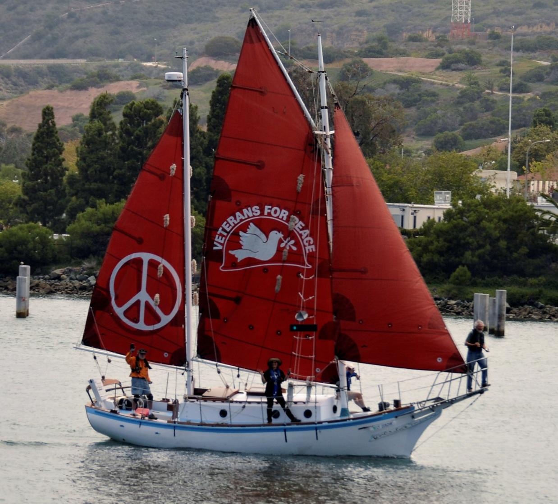
The Golden Rule Peace Boat, 2015
Notes:
This is the story of the Golden Rule, which helped to end nuclear bomb tests in the Marshall Islands.

Slide 2
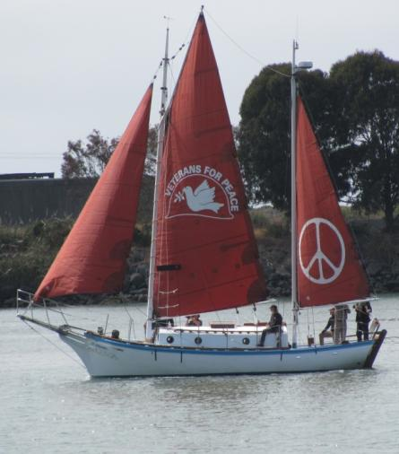
ゴールデンルール ピースボート
核の無い世界と平和で持続可能な未来への航海
ベテランズフォーピース
ゴールデンルールプロジェクト
www.vfpgoldenruleproject.org
vfpgoldenruleproject@gmail.com
フェイスブック: Golden Rule Peace Boat
電話： (314) 725-6005
VFP Golden Rule Project
P.O. Box 87
Samoa, CA 95564
ヘレン・ジャッカード
プロジェクト マネージャー
Helen.Jaccard@gmail.com
206-992-6364

Slide 3
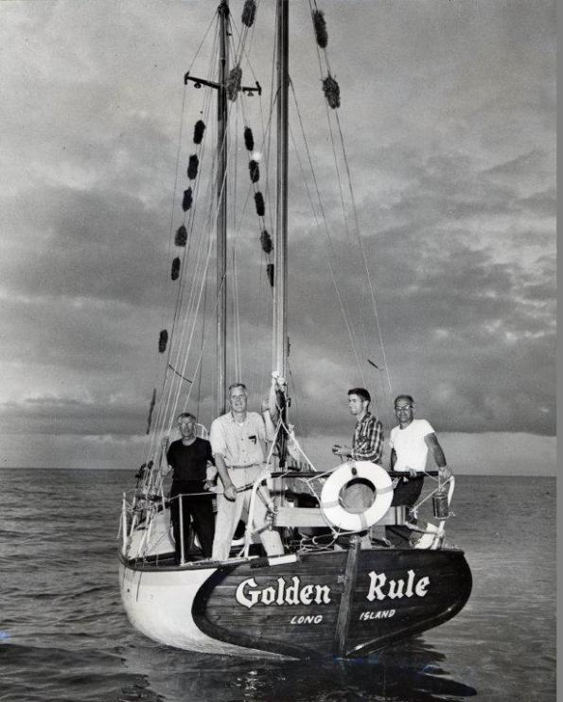
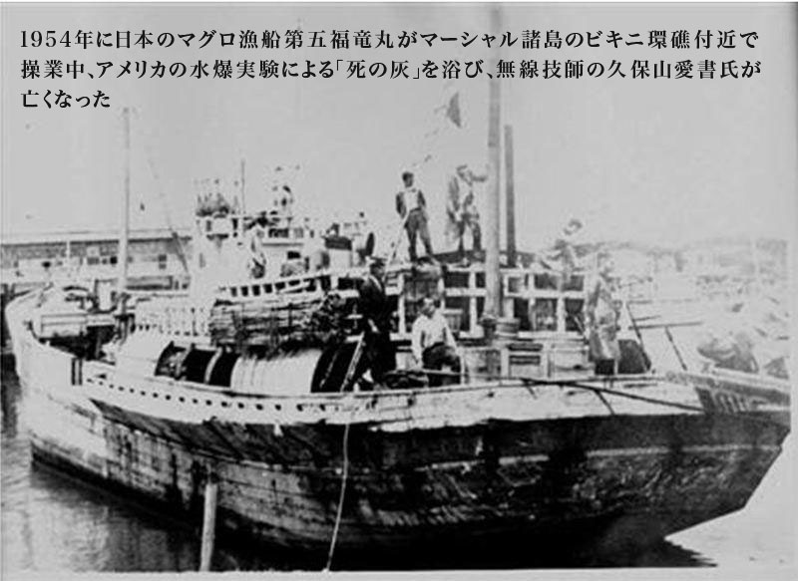
ゴールデンルール : 1958 年当時のミッション
１９５８年に４人のクエーカー教徒の反核・平和アクティビストがゴールデンルール号をマーシャル諸島に向けて出航し、核兵器実験を止めようとしました。
第五福竜丸事件の四年後のことでした。
ウィリアム・ハンティントン, アルバート・ビゲロー船長, オリオン・シェーウッド、 ジョージ・ウィロビー

Slide 4
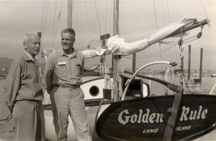
広島と長崎への
原爆攻撃
Notes:
ゴールデンルール号のキャプテン、アルバート・ビゲローは、道徳的義務を感じました。第二次大戦中彼は海軍将校でした。
護衛駆逐艦の艦長をつとめている間、広島の原子爆弾の投下のニュースを知り、彼らはサンディエゴから真珠湾に接近しました。
「直観的に、当時、戦争というものが道徳的に不可能であると初めて気づいたのでした。」年金受給の1ヵ月前に辞任したことを、彼は誇りに思っていました。
ボートとクルーの命をかけてまで、なぜ彼らクエーカー教徒らは、小さなボートを太平洋のど真ん中へと繰り出したりしたのでしょうか？
a) 広島長崎への原爆投下

Slide 5
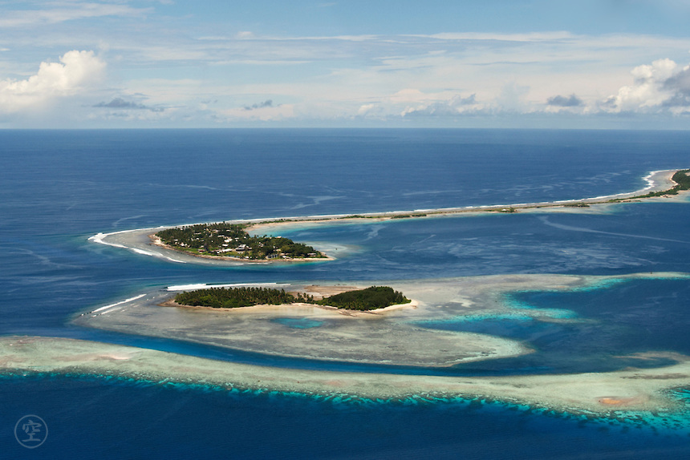
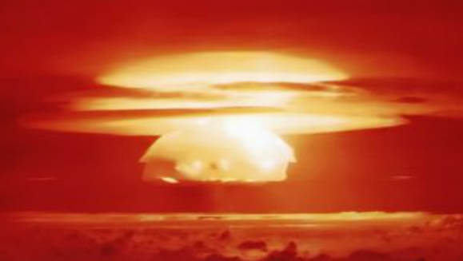
1946 年から1958年まで, 米国はマーシャル諸島で67回の核実験を行った
Notes:
The U.S. conducted 67 nuclear tests in the Marshall Islands from 1946 through 1958.
The amount of radiation spread during this period is equivalent to: 1.5 times more of Hiroshima bomb detonated every single day for 12 years!
FYI: France conducted nuclear tests in Tahiti for 193 times!

Slide 6
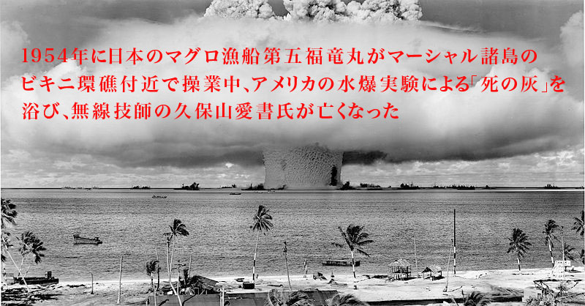
核実験:
1954年マーシャル諸島のビキニ環礁
キャッスルブラボー実験で使われた１５メガトンの核爆弾は
広島原爆１０００発分の威力
Notes:
ボートとクルーの命をかけてまで、なぜ彼らクエーカー教徒らは、小さなボートを太平洋のど真ん中へと繰り出したりしたのでしょうか？
c) マーシャル諸島と島民の暮らしを破壊
Equivalent of 1.5 Hiroshima-size bombs dropped every day for 12 years

Slide 7
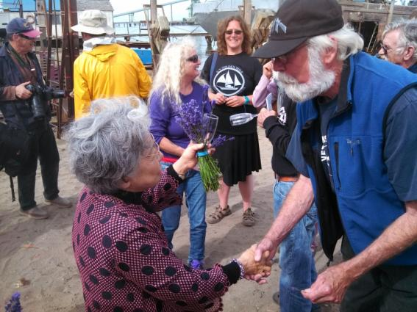
原爆乙女
シゲコ
ササモリ
2015年6月20日ハンボルト湾に到着したゴールデンルール号を訪れた笹森さん
Notes:
広島の原爆乙女はゴールデンルール号初代のクルーに多大な影響を与えました。彼らは、市民的不服従から太平洋で核実験を止めようとしたのでした。
バート・ビゲローの家族は、1年以上の間7歳と13歳の少女2人を接待しました。
笹森成子氏がその一人で、広島原爆を生き伸び、米国に整形手術にきたのでした。
ボートとクルーの命をかけてまで、なぜ彼らクエーカー教徒らは、小さなボートを太平洋のど真ん中へと繰り出したりしたのでしょうか？
b) The Hiroshima Maidens

Slide 8
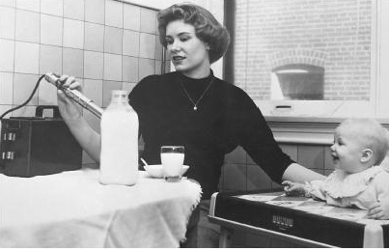
母乳にも牛乳の中にもストンチウム90
Notes:
Strontium 90 in mother’s and cow’s milk
As a result of the atmospheric nuclear bomb tests by the U.S., U.K, and Russia, ⁹⁰Sr was found in milk, and the “Baby Tooth Survey” levels of ⁹⁰Sr were found to be 50 times higher between 1950 and 1963. Initial findings published in 1961 helped convince Kennedy in 1963 to sign the Partial Nuclear Test Ban Treaty.
Strontium 90 is not naturally occurring, but occurs only as a product of nuclear fission – from spent nuclear fuel and fallout from nuclear tests.
Sr90 is a calcium-demand seeker replacing calcium in the bones or breast milk, causing bone cancer and leukemia.
米国、英国、やロシアの行った大気圏内核実験の結果です。そして、ストロンチウム90はミルクで見つかり、そして、「乳歯調査」で、1950～1963年に50倍より高いとわかりました。1961年発表の最初の評決は、1963年のケネディに部分的核実験禁止条約に署名させるのに十分でした。
ストロンチウム90は自然界に存在しないで、核分裂の結果としてのみ、生まれます – 核実験からの使用済み核燃料と放射性降下物から。
ストロンチウム90はカルシウムに似た物質で、骨・母乳でカルシウムのように吸収され、骨のガンや白血病を引き起こします。
ボートとクルーの命をかけてまで、なぜ彼らクエーカー教徒らは、小さなボートを太平洋のど真ん中へと繰り出したりしたのでしょうか？
d) ストロンチウム90を含む放射能が地球全体を回った

Slide 9
非暴力・直接行動の基礎を築く
手紙、電話、国会議員や大統領への陳情
新聞・雑誌への投書や寄稿
テレビやラジオのインタビュー
抗議活動、デモ
Notes:
Still, you don’t just sail a small boat into the Nuclear Testing Zone.
First, you try everything possible to get the nuclear bomb tests stopped.

Slide 10
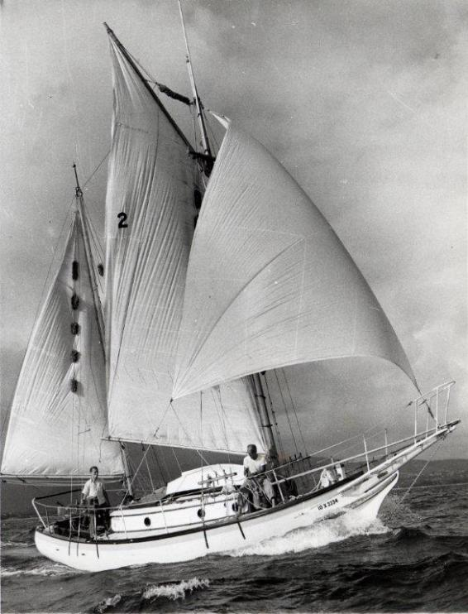
そして いよいよ出航
Notes:
By the time the Golden Rule left Los Angeles, many people knew what the boat and crew were trying to do.
The US government, newspapers, and the general public had all been informed about the upcoming Voyage of the Golden Rule.

Slide 11
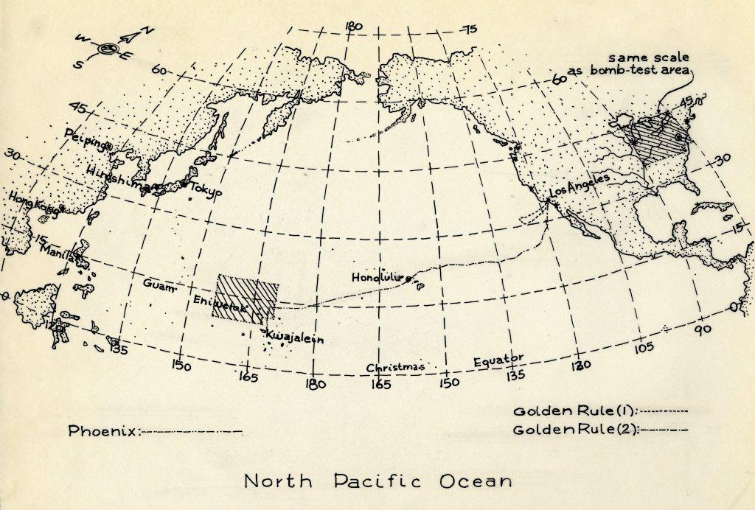
カリフォルニアからハワイを経てマーシャル諸島へ
Notes:
The Golden Rule sailed out of Los Angeles in February 1958. On March 25 they sailed again. Orion Sherwood took David Gale’s place. The weather was much better as they made their way to Honolulu.

Slide 12
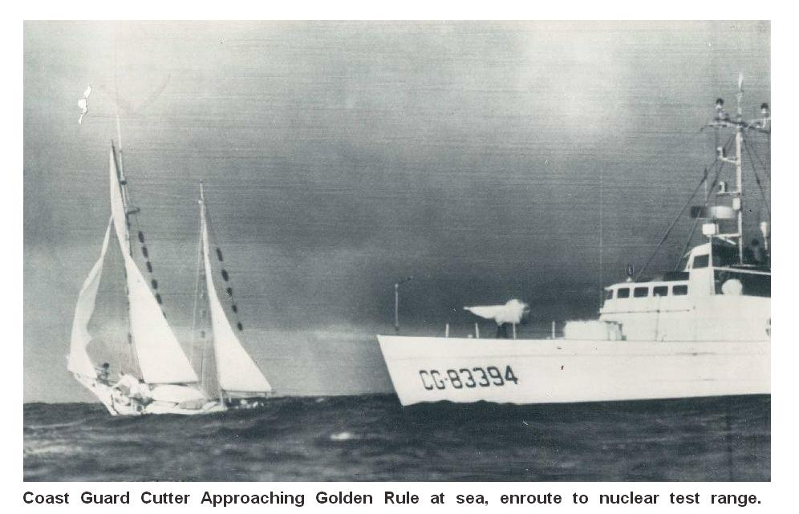
核実験海域に向かうゴールデンルール号に接近する沿岸警備艇
Notes:
While the Golden Rule was at sea on their way to Honolulu, the US Atomic Energy Commission made a rule that no US citizen shall enter the atomic testing zone in the Marshall Islands.
They made it to Honolulu and re-supplied, but were brought back by the US Coast Guard for intending to break the “Golden Rule” Rule.

Slide 13
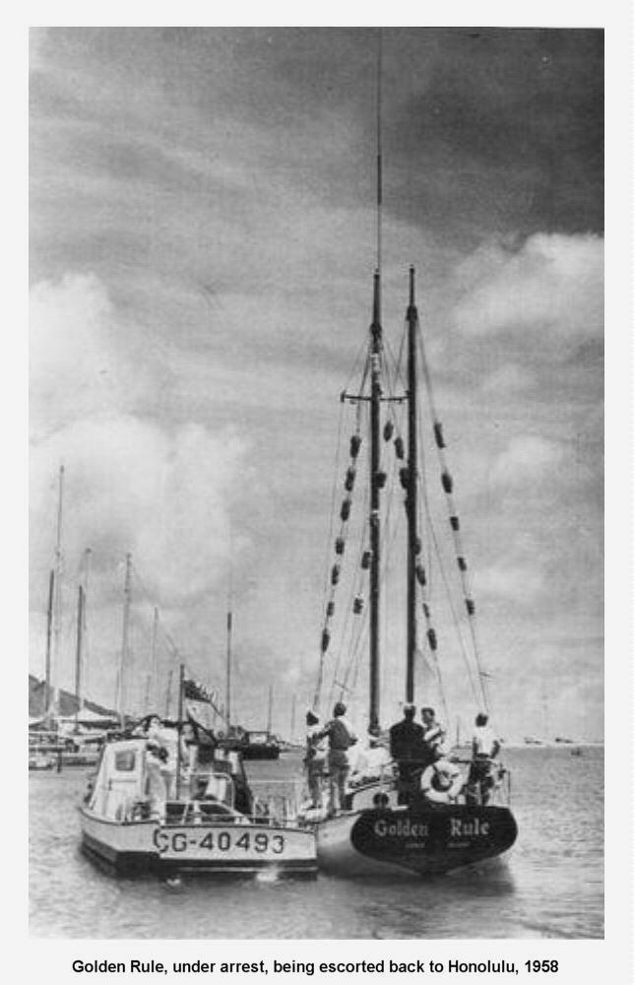
逮捕され、ホノルルに連れ戻されるゴールデン・ルール号
Notes:
A second attempt to leave Honolulu to go to the Marshall Islands – this time a smaller Coast Guard vessel caught up with them in international waters and brought them back.

Slide 14
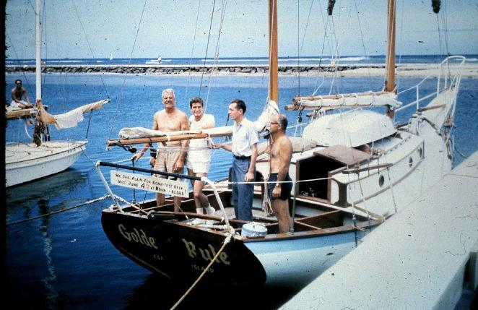
逮捕後、禁固６０日間の求刑
Notes:
"WE SAIL AGAIN FOR BOMB-TEST AREA WED. JUNE 4TH AT NOON -- ALOHA!"
Crew, left to right: Capt. Albert S. Bigelow, Orion Sherwood, William Huntington, and George Willoughby
Photo courtesy of Jessica (Reynolds) Renshaw
The crew was arrested and spent 60 days in jail. One of the crew caught tuberculosis while in the Honolulu city jail.

Slide 15
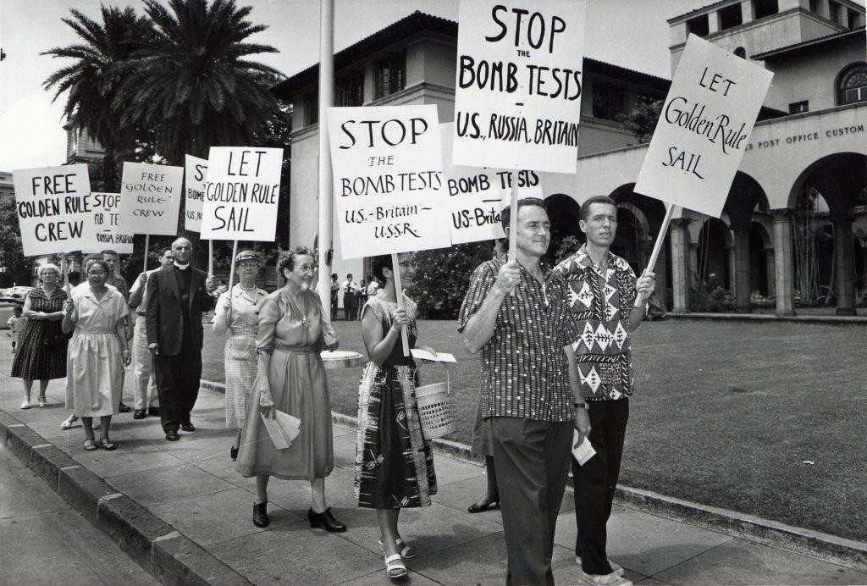
ホノルルでの核反対抗議デモ
Notes:
All over the country people protested the bomb tests and the arrest of the Golden Rule crew

Slide 16
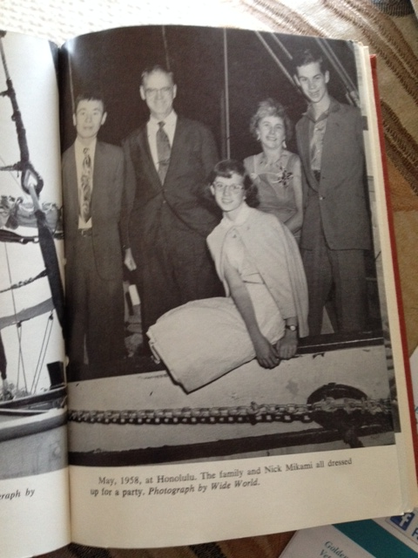
広島で作られ、
レイノルズ一家４人と日本人造船技師を乗せて、 世界を一周
フェニックス号
ニック・三上、
アール・レイノルズ博士、ジェシカ（娘）、
バーバラ（妻）、
テッド（息子）
Notes:
During the trial of the Golden Rule crew, the Phoenix of Hiroshima came to the same dock as the Golden Rule.
The captain was Dr. Earle Reynolds, who had spent 3 years studying the effects of radiation on children in Hiroshima.
He modified a Colin Archer boat design and it was built by hand, no power tools, in Hiroshima.
Then he and his wife Barbara, son Ted, daughter Jessica and Miichi Mikami sailed for 3 years around the world. (Mr. Mikami lost his only brother to the atomic bomb in Hiroshima)
They were on their way back to Hiroshima when they came to Al Awai harbor in Honolulu.
They heard about the Golden Rule and her crew and went to the trial. It changed all of their lives forever!
The family and Mr. Mikami decided to take the baton from the crew of the Golden Rule, and they DID sail into the Marshall Islands nuclear bomb test zone!
Dr. Reynolds was arrested and underwent 2 years of trial in Honolulu. He was convicted, but the conviction was overturned because the “Golden Rule” Rule was illegal blockage of Freedom of International Waters
It was the combination of the voyage of the Golden Rule and the Phoenix and the publicity around these voyages that helped convince President Kennedy to sign the Limited Nuclear Test Ban Treaty of 1963 with the U.S.S.R. and the U.K.

Slide 17
カリフォルニアからハワイを経てマーシャル諸島へ

Slide 18
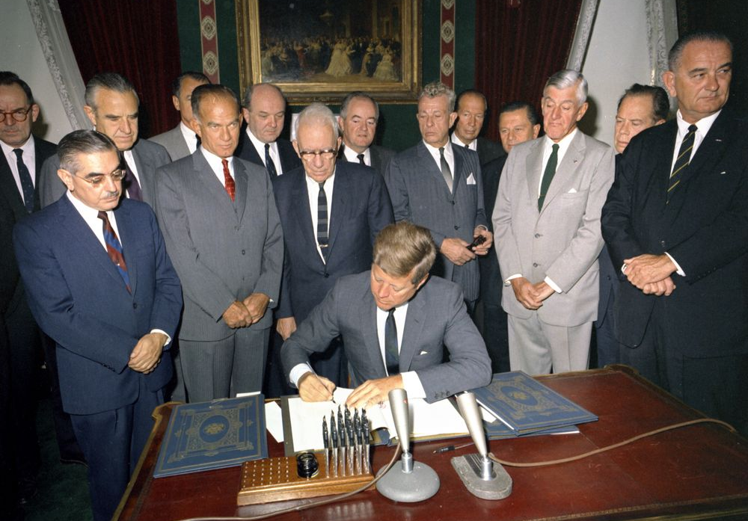
英国とソ連とともに、部分的核実験禁止条約に調印するケネディー大統領 1963年
President Kennedy signed the Limited Nuclear Test Ban Treaty with the UK and USSR 1963

Slide 19
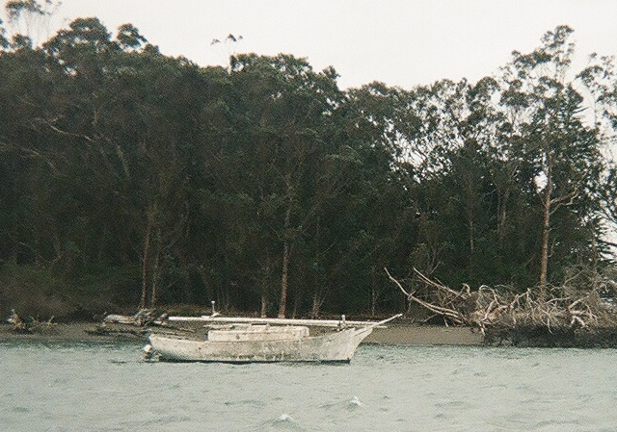
２０1０年 カリフォルニア州、ユーレカ、ハンボルト湾で
発見されたゴールデン・ルール号
Notes:
In terrible shape, the Golden Rule floated in Humboldt Bay for months before she sank in a gale.

Slide 20
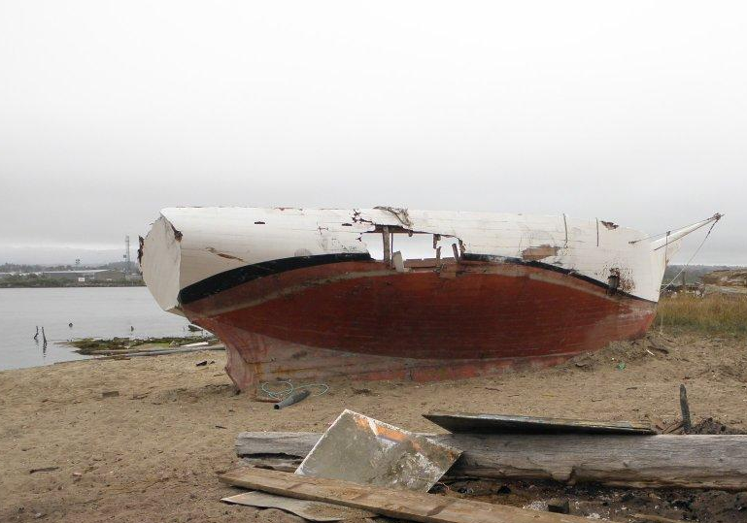
Notes:
She was tied to a dock and developed two holes in her side.
Leroy Zerlang had her brought up onto the sand at his boat yard.
He called his friend Chuck DeWitt (a member of Veterans For Peace) and said, “Chuck, let’s share a bottle of Maker’s Mark (rum) and have a bonfire with the Golden Rule!”
Instead, Chuck, many members of Veterans For Peace, Quakers, and others said, “Leroy, how about you give us a year in your boat yard and we’ll restore this old boat”

Slide 21
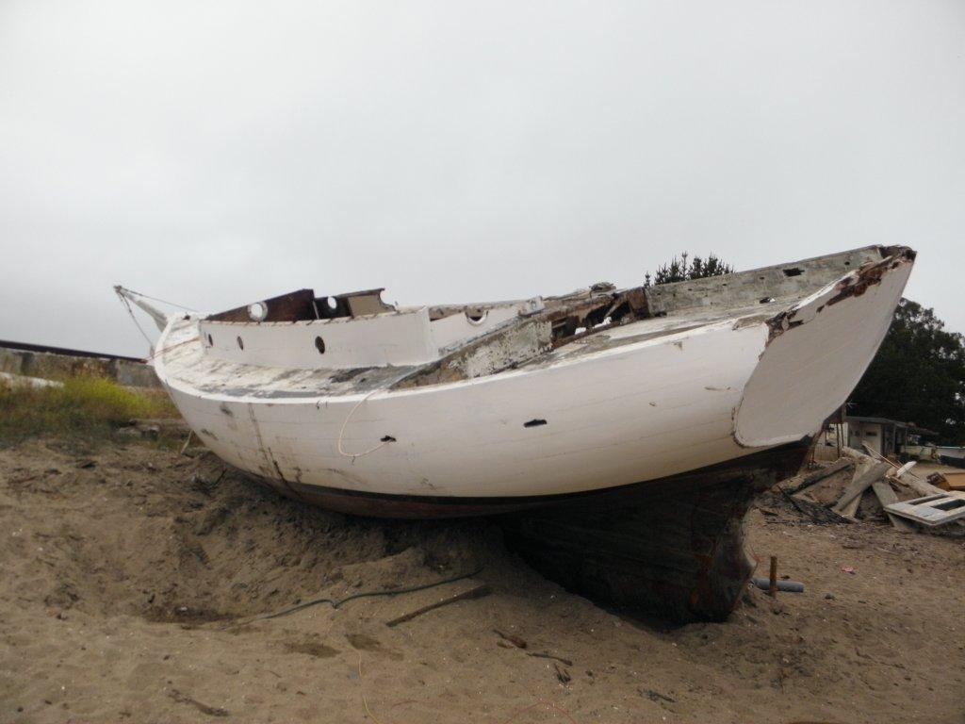

Slide 22
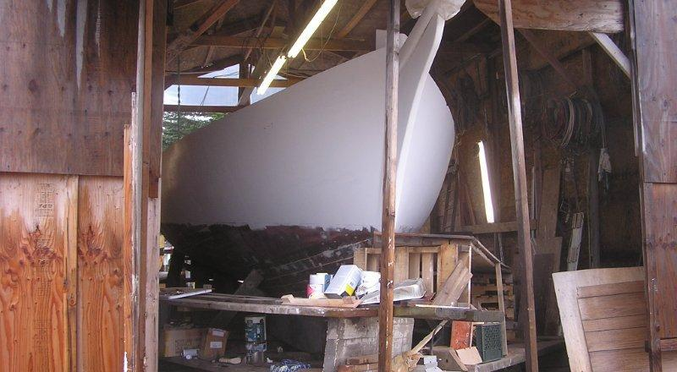
ゴールデン・ルール号の修復
Notes:
Leroy, a historian, agreed to the reconstruction project. They built a house over the Golden Rule so they could work in the winter.

Slide 23
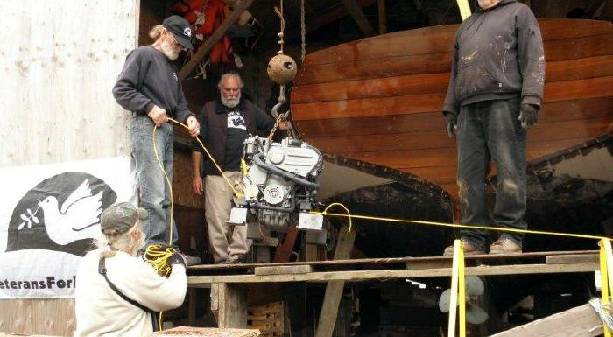
Notes:
They got a new engine

Slide 24
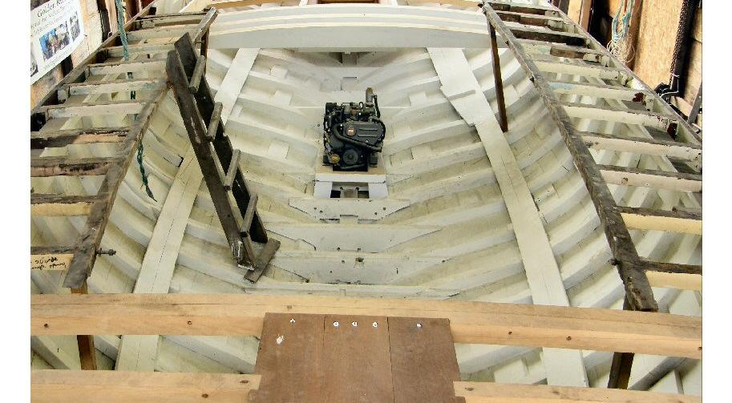
船体内部の修復
Notes:
Everything had to be re-built except the hull, keel, and transom. One of the masts, the rudder and tiller were also salvaged and used again. The rudder and tiller have since broken and been replaced.
The ribs were re-inforced and the hole patched.

Slide 25
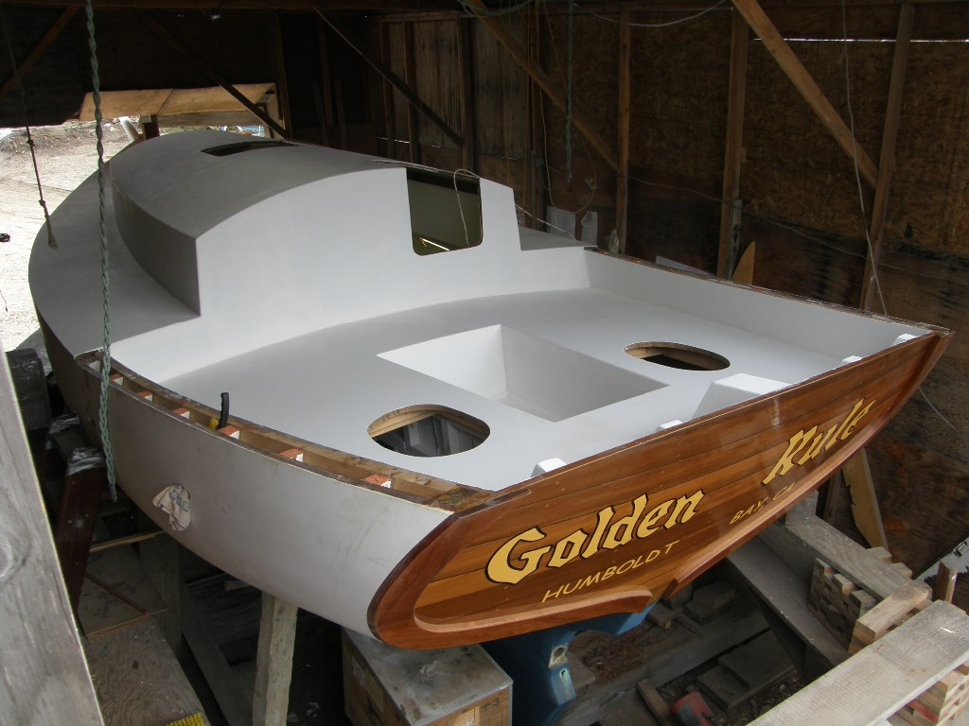
Restoration by Veterans for Peace
Notes:
Now she’s starting to look like she could float!

Slide 26
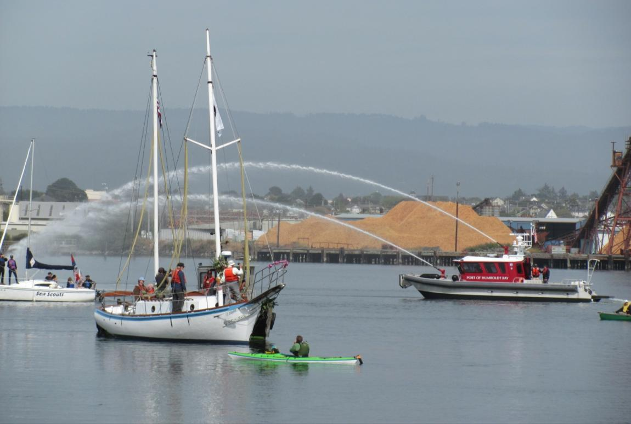
2015年6月20日に進水！
Notes:
And finally, five years later, she was launched into Humboldt Bay to much fanfare and with hundreds of people cheering her on!

Slide 27
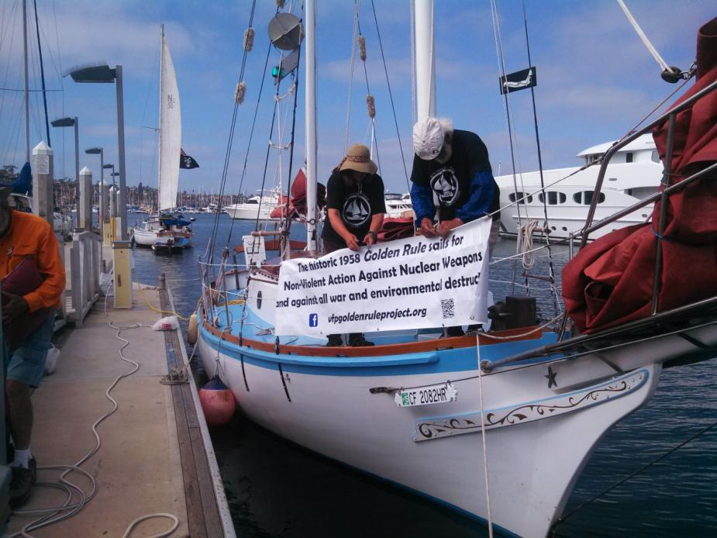
サンディエゴに到着
Notes:
At least 3 TV stations, 1 radio station, and 1 newspaper covered our arrival! We were met by VFP members and supporters and Golden Rule was the “sparkle” in the VFP National Convention!
Her first voyage was to San Diego, arriving August 1, in time for the Veterans For Peace National Convention and for the commemoration of Hiroshima and Nagasaki 70th anniversaries.
On the way back to Humboldt Bay, we stopped at 10 ports to give educational presentations about the history of the Golden Rule and nuclear issues today.

Slide 28
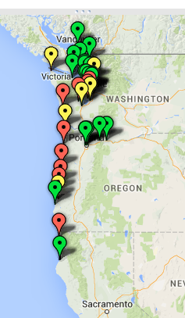
2016年の航海実績
非暴力直接行動
さらなる知識を深めて
  25 教育イベント
新しい仲間を求めて
  4 木造ボートショー
  先住民カヌーの旅
  ボートツアーとセーリング
  チラシ配布– 薔薇祭り、海の祭り、広島からホープへ
Notes:
In 2016, she headed north to Oregon, Washington and British Columbia, Canada.
non-violent direct action
4 water protests: Indian Island, Fleet Week Portland, Seattle, Boats by Bangor
25 educational events
Beyond the choir:
4 wooden boat shows
Indigenous Canoe Journey
Children, take people sailing
Distribute flyers at Hiroshima to Hope, Rose Festival

Slide 29
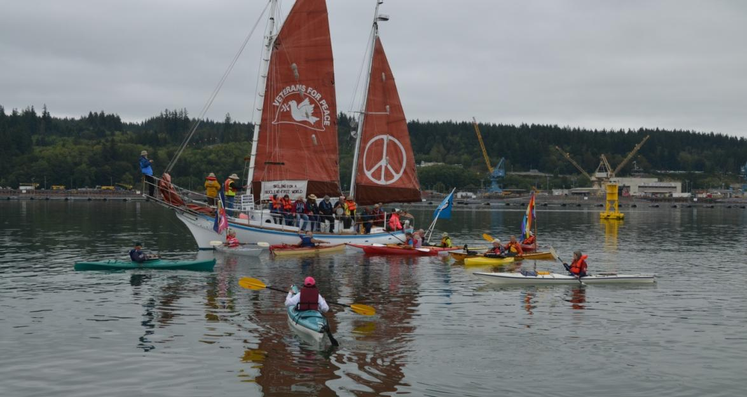
バンゴー基地に集まるボート
♦ ８艇のトライデント型原子力潜水艦はシアトルからわずか40km先の港を母港とする
♦ どれも地球を破壊するに十分な核兵器を搭載
♦ フード運河にあるバンゴー基地は、米国内最大の核兵器を貯蔵
Notes:
Our water protests are a lot of fun and the media often write articles about the Golden Rule Project.

Slide 30
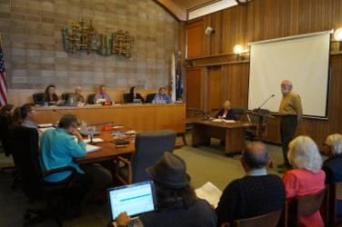
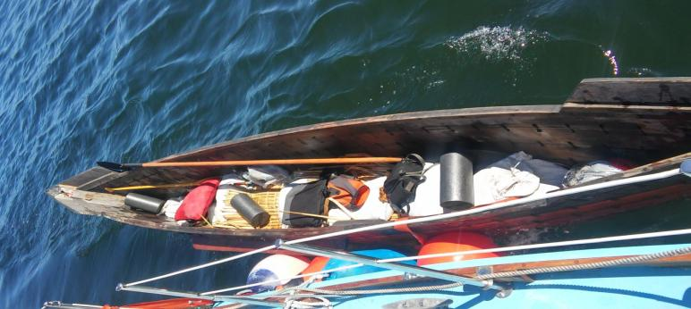
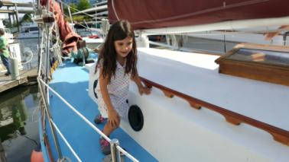
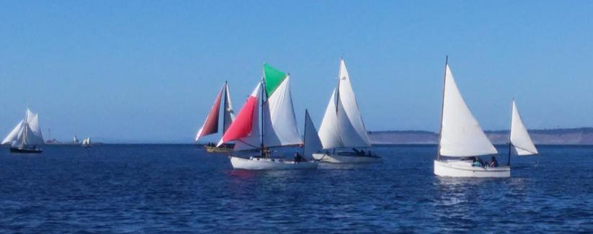
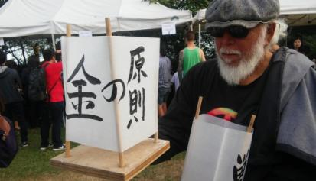
新しい人々に届ける
地方自治体
先住民のカヌーの旅を助ける
ボートツアーやセイリング
木製ボートのショーやレース
地域のイベントに参加する
Notes:
In addition to helping invigorate the anti-nuclear and peace activists, we try to spread the word to many others about the dangers of nuclear weapons and nuclear energy.

Slide 31
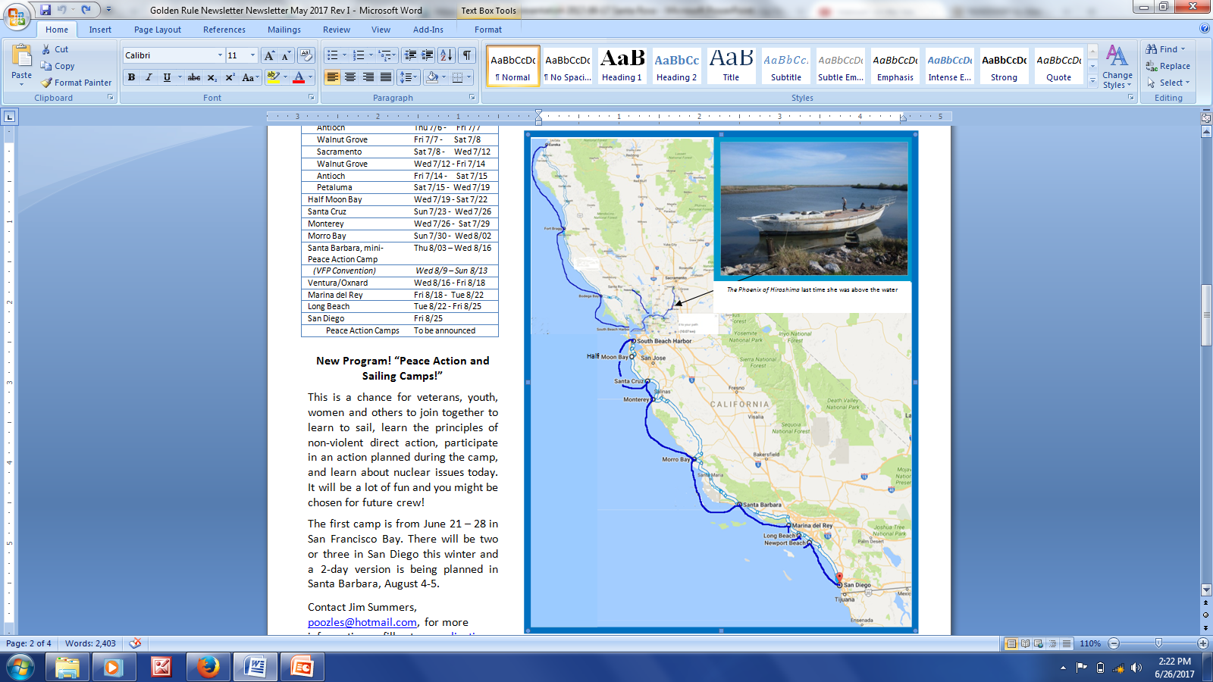
〜 今年の活動 〜
♦ 2017 年の航海: ハンボルト湾からサンディエゴへ
♦ 18の港で21回の教育的トークセッションを開催
♦ ２つの海軍ショーで抗議活動を行う
♦市中のパーティーで海軍の妨害を受ける
♦広島にあるフェニックス寄港地を訪問
♦目下、サンディエゴで越冬中

Slide 32
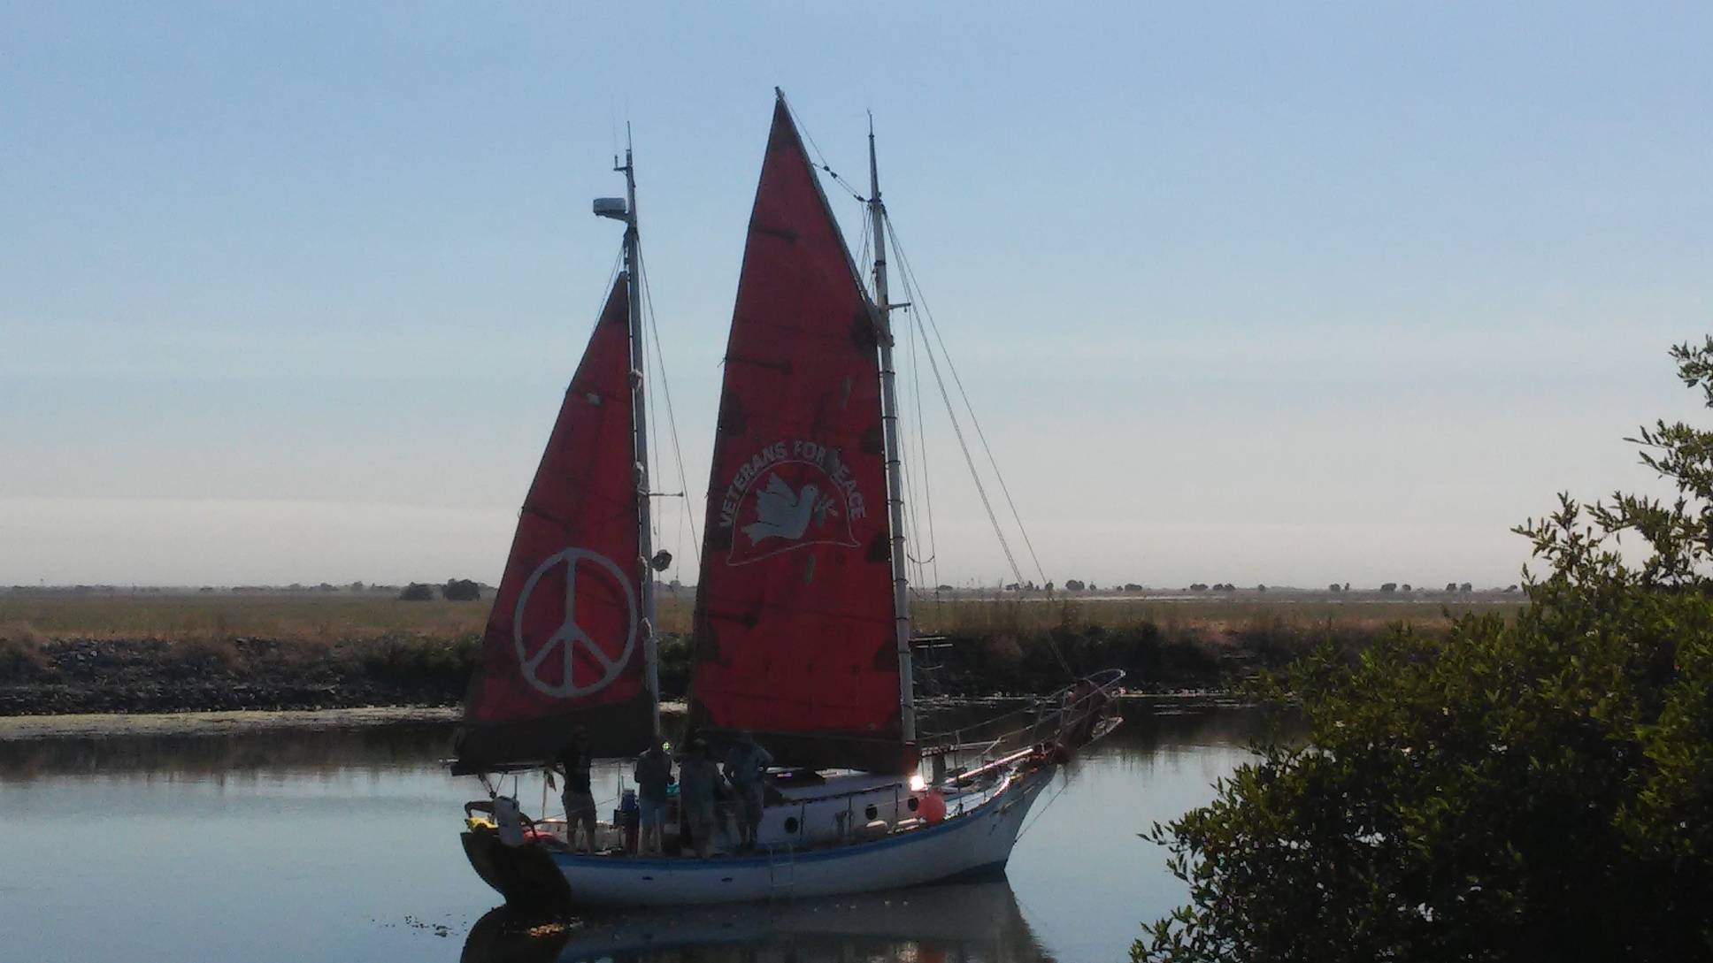
フェニックス号とゴールデンルール号の再会

Slide 33
今日の核問題
    緊迫する核戦争の危機
    日米原子力協定自動更新の意味
    核保有国同士の対立
    新型、破壊力強化、使用可能な核兵器
    原子力 核エネルギー
    メルトダウン, 廃棄物, 金
ウラン鉱、抽出施設、輸送、処理
    致死的悪影響、汚染
    過去と現在
Notes:
Nuclear Issues Today
Increased Threat of Nuclear War –
Conflicts between Nuclear States
US-Japan Nuclear Agreement
New, more deadly, useable nuclear weapons
Nuclear Power – Meltdowns, Waste, Money
Uranium Mines, Mills, Transport, Processing – killing and contaminating - then and now

Slide 34
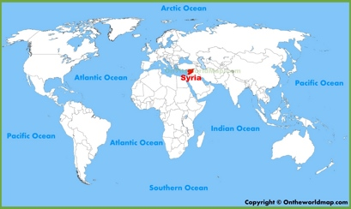
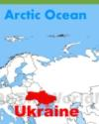
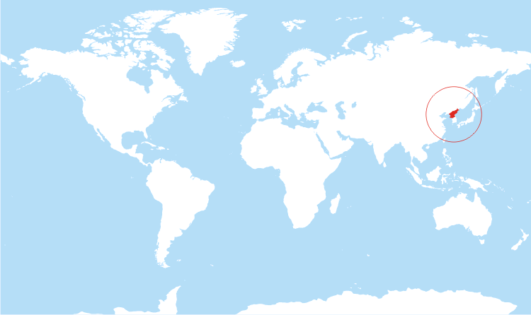

核保有国同士の摩擦
Kashmir
Korea
ウクライナ: 米国, ロシア
シリア: 米国, ロシア
カシミア: インド, パキスタン
南シナ海, 他のアジア地区: 米国, 中国
朝鮮半島: 米国, ロシア, 中国, 北朝鮮, 韓国
Notes:
http://drrajivdesaimd.com/2012/08/01/the-war/
Ukraine: US, Russia
Syria: US, Russia
Kashmir: India, Pakistan
S. China Sea, other Asian areas: US, China
Korea: US, Russia, China, N. Korea, S. Korea

Slide 35
  「延命」や「近代化」の名目での
  新しい、殺傷力増強、使用可能な核兵器
♦ １兆ドルの予算を投じ、２つの新しい核兵器と
３つの新しい標的攻撃システムを導入する米国
♦ 核兵器「近代化」にロシアと中国も参入
Notes:
$1,000,000,000 (One Trillion Dollars) planned for 2 new nuclear weapons and 3 new nuclear weapon delivery systems in the U.S. alone. Russia and China are also “modernizing” their nuclear weapons.

Slide 36
国連核兵器禁止条約
♦ 使用、所有、開発、実験、配備、譲与を国際法で禁止
♦ 非核保有国グループが、核戦争がもたらす壊滅的な人道的被害に焦点を当てている
Notes:
James Martin Center for Nonproliferation Studies at the Middlebury Institute of International Studies at Monterey
UN Treaty (Rachel)
The Nuclear Weapons prohibits the use, possession, development, testing, deployment and transfer of nuclear weapons under international law.
Current nuclear weapons ban project has its origins in the Humanitarian Initiative, a group of non-nuclear weapons states who have sought to push nuclear disarmament forward by focusing on the severe humanitarian consequences of nuclear war.
(Rest needs to be re-written)

Slide 37
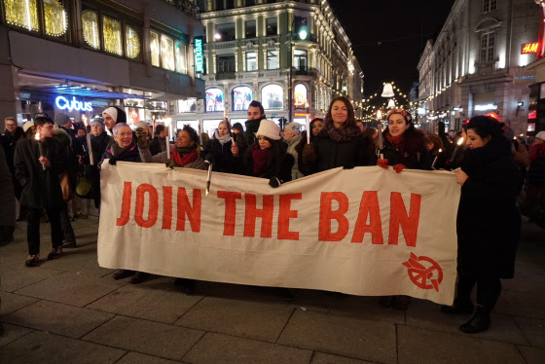
ICANがノーベル平和賞を受賞！

Slide 38
ICANがノーベル平和賞を受賞
2017年12月11th、「核兵器廃絶国際キャンペーン（ICAN）がノーベル平和賞を受賞
国連の核兵器廃絶条約制定に果たした重要な役割が高く評価された
ICANは核兵器廃絶に長年尽力してきた世界の全ての人と共に受賞することに
ゴールデンルールはこれを追い風に！
地球の自己破壊を逃れる努力を奨励
Notes:
NOBEL PEACE award has given to ICAN on December 11, 2017

Slide 39
核戦争の可能性を減らす為にできること
国連の核兵器廃絶条約に日本が調印するように働きかけること
日米原子力協定の自動更新を阻止するよう 今から運動を起こすこと
核発電所の廃炉のスペシャリストを目指すこと
Notes:
What you can do to reduce the possibility of nuclear war
Encourage US involvement in the UN Nuclear Weapons Ban negotiations and treaty ratification
Support the Markey-Lieu bill – The US shall not strike first with nuclear weapons without a Congressional Declaration of War
(need to rewrite this for Japan audience)

Slide 40
核発電
核発電所は：
慣例的に放射能を放出する
炉心溶融の危険性
核兵器に用いるプルトニウムを含む燃料棒を生産
Notes:
Nuclear Power
Nuclear power plants routinely release radioactivity, are at risk of melt-down, and produce fuel rods containing plutonium for bombs.

Slide 41
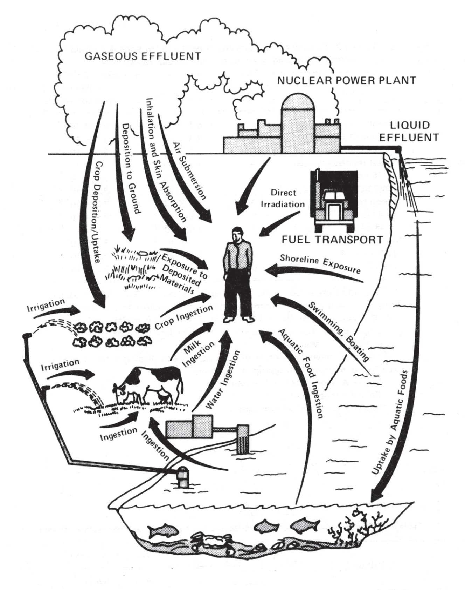
核発電所からの慣例的な放射能の放出
Notes:
1. Every nuclear power reactor dumps radioactive water, scatters radioactive
particles, and disperses radioactive gases as part of its routine, everyday operation.
It doesn’t take an accident. Federal regulations permit these radioactive releases.
2. Radioactivity is measured in curies. An average operating nuclear power
reactor will have about 16 billion curies in its reactor core. This is the equivalent
long-lived radioactivity of at least 1,000 Hiroshima bombs. In contrast, a large medical
center, with as many as 1,000 approved laboratory areas in which radioactive
materials are used, may have a combined inventory of only about two curies.
3. Many of a reactor’s byproducts give off radioactive particles and rays for
enormously long periods --- described in terms of “half-lives.” For example, iodine-129
has a half-life of about 16 million years; technetium-99 = 211,000 years; and
plutonium-239 = 24,000 years. Xenon-135, a noble gas, decays into cesium-135,
an isotope with a 2.3 million-year half-life. Radioactive materials give off hazardous
radioactivity for at least ten half-lives.
4. A reactor’s fuel rods, pipes, tanks and valves can leak. Mechanical failure and
human error can also cause leaks. As a nuclear plant ages, so does its equipment
--- and leaks generally increase.
5. Liquid releases:
a. Some contaminated water is intentionally removed from the reactor’s cooling
system to reduce the amount of radioactive and corrosive chemicals that damage
valves and pipes. This water is filtered and then either recycled back into the cooling
system or released into the environment.
b. A typical 1000-megawatt pressurized water reactor (with a cooling tower) takes
in about 20,000 gallons of river, lake or ocean water per minute for cooling; circulates
it through a 50-mile maze of pipes; returns about 5,000 gallons per minute to the same
body of water; and releases the remainder to the atmosphere as vapor. A similar reactor
without a cooling tower can take in as much as one-half million gallons per minute. The
discharge water is contaminated with radioactive isotopes in amounts that are
not precisely tracked and are potentially biologically damaging.
c. Government regulations allow radioactive water containing “permissible” levels
of contaminants to be released to the environment. Permissible does not mean safe.
Detectors at reactors are set to allow radioactive water to be released, unfiltered, if
below the “permissible” legal levels.
6. Gaseous releases:
Some radioactive gases, stripped from the reactor cooling water, are retained in
decay tanks for days before being released into the atmosphere through filtered roof
top vents. Some gases leak into the power plant buildings’ interiors and are released
during periodic “purges” or “ventings.” These airborne gases contaminate not
only the air, but also fall out upon soil and water.
7. Radioactive releases from a nuclear power reactor’s routine operation often are
not fully detected or reported. Accidental releases also cannot be completely
verified or documented.

Slide 42
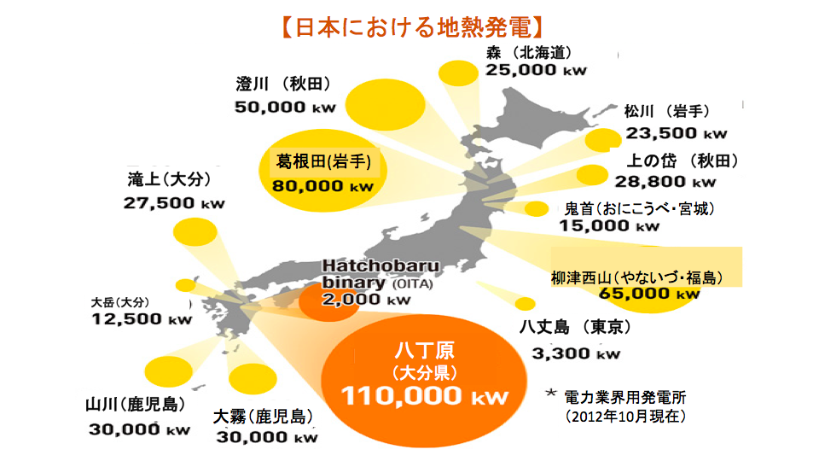
Notes:
Geothermal Power in Japan

Slide 43
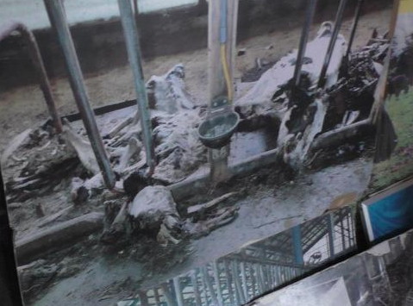
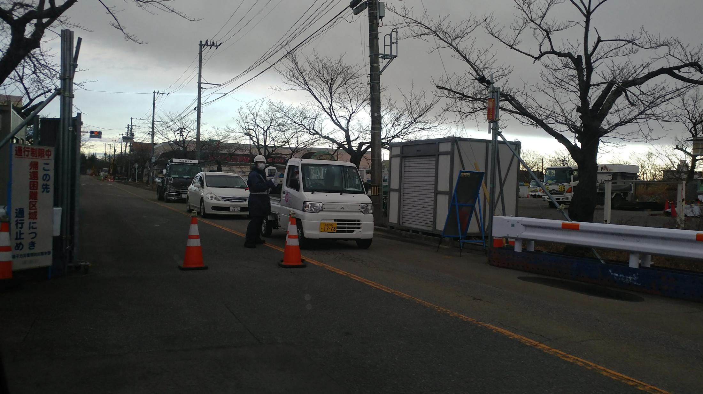
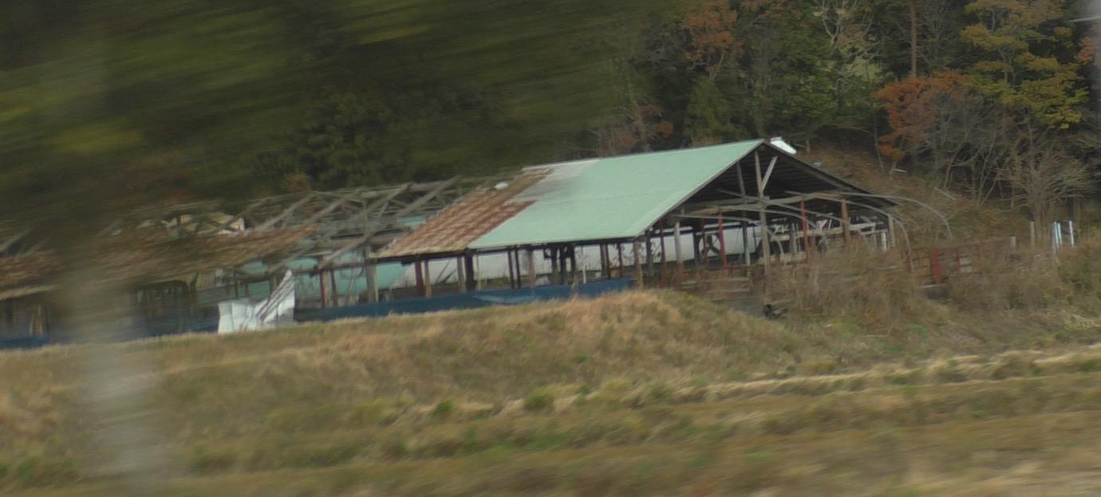
福島に行って観てきました
ゴーストタウン
空き家、放置された農地
閉鎖された道とゲート
マスクをした係員
Notes:
Observations From Fukushima
Ghost towns, abandoned homes and farms, roadblocks and closed gates, workers with masks

Slide 44
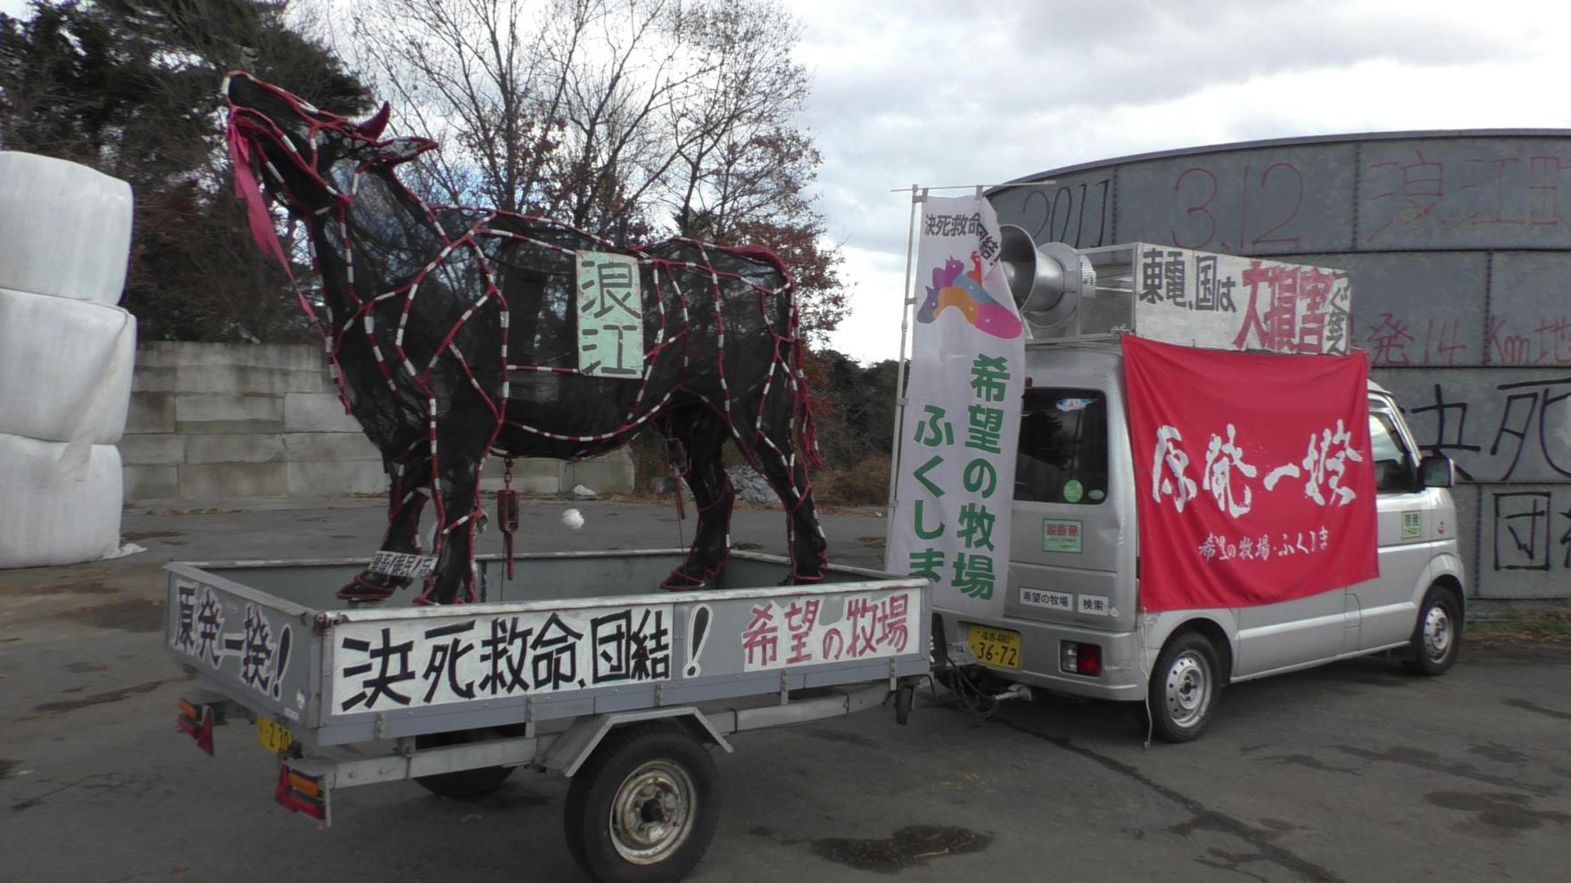
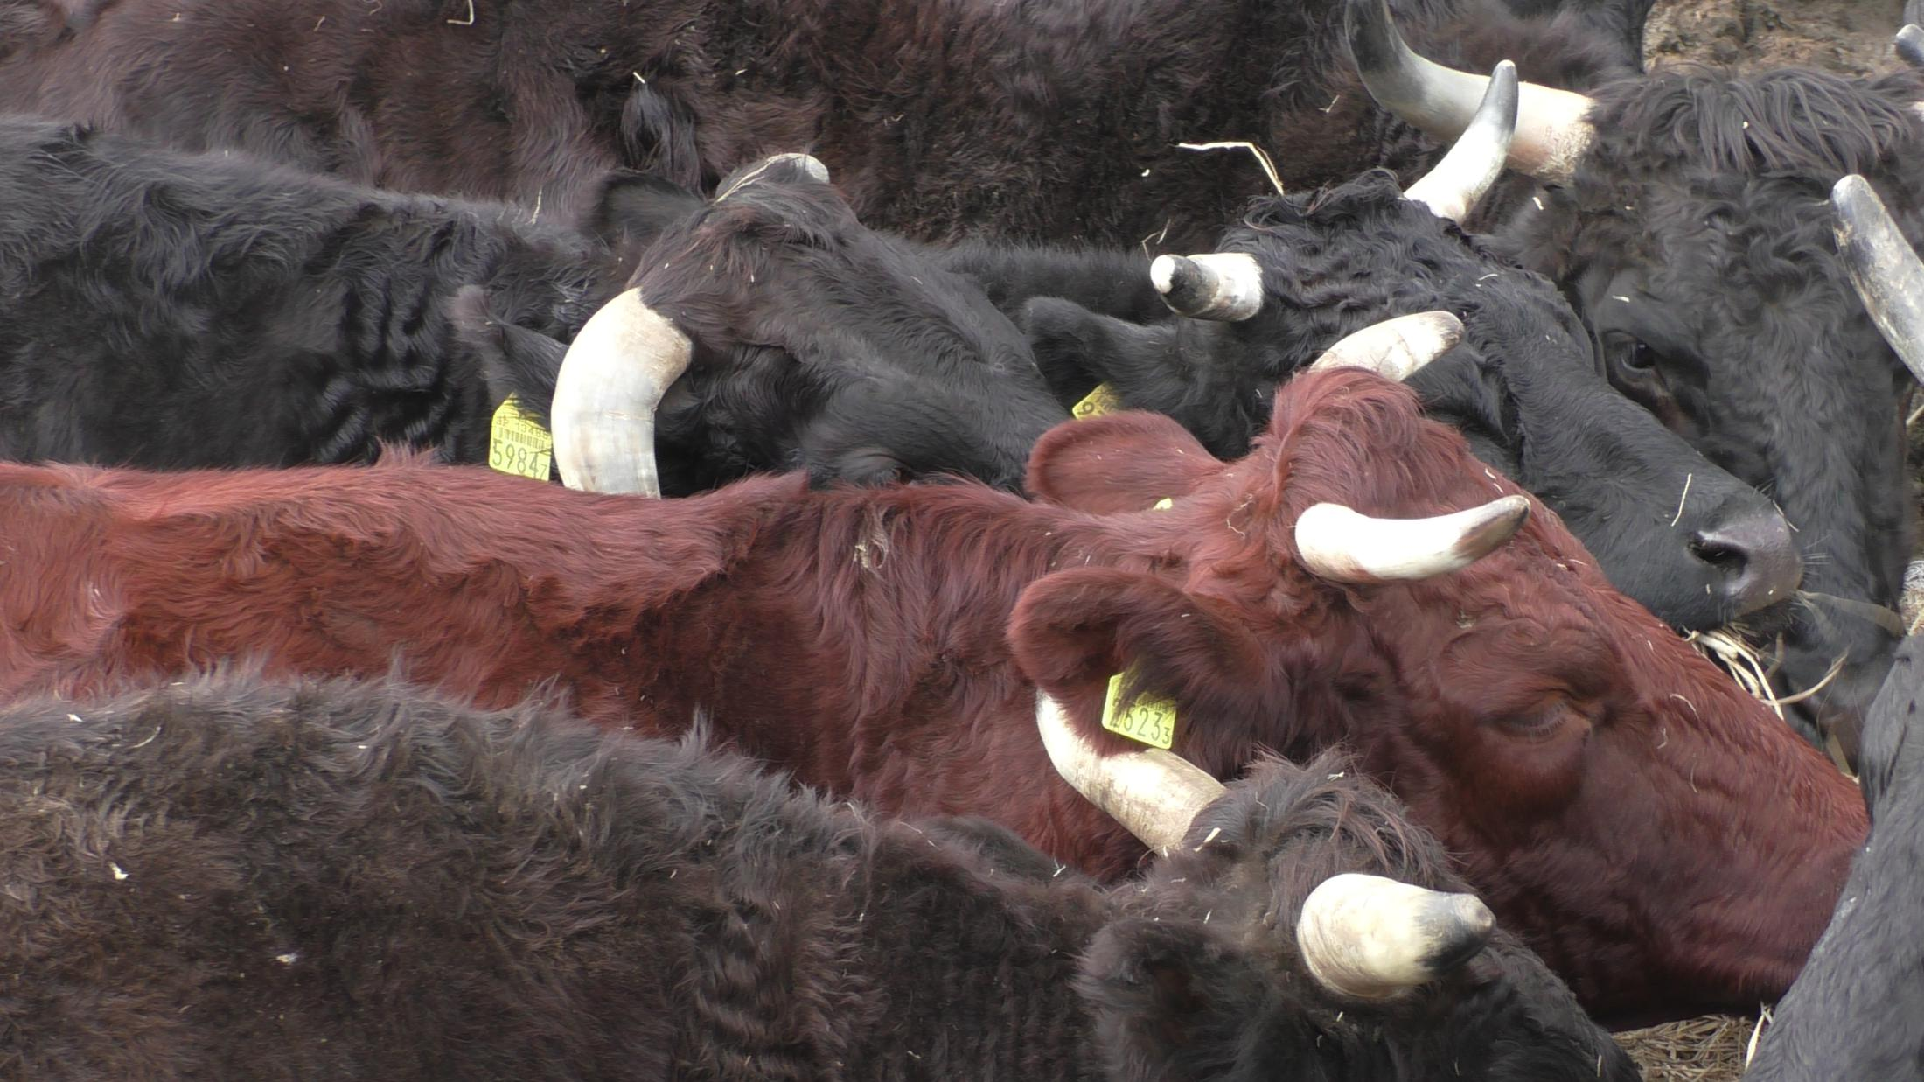
ほとんどの農家が家畜を飢え死にさせたり、警戒区域では行政指導によって殺処分。中には人道的配慮と抗議のために今も飼い続けている人たちも数人いる。
Notes:
Although most farmers abandoned their animals, some to die horrible death of starvation, and in the ”caution zone,” animals were ordered to under euthanasia. A few stayed to care for their animals out of compassion and protest

Slide 45
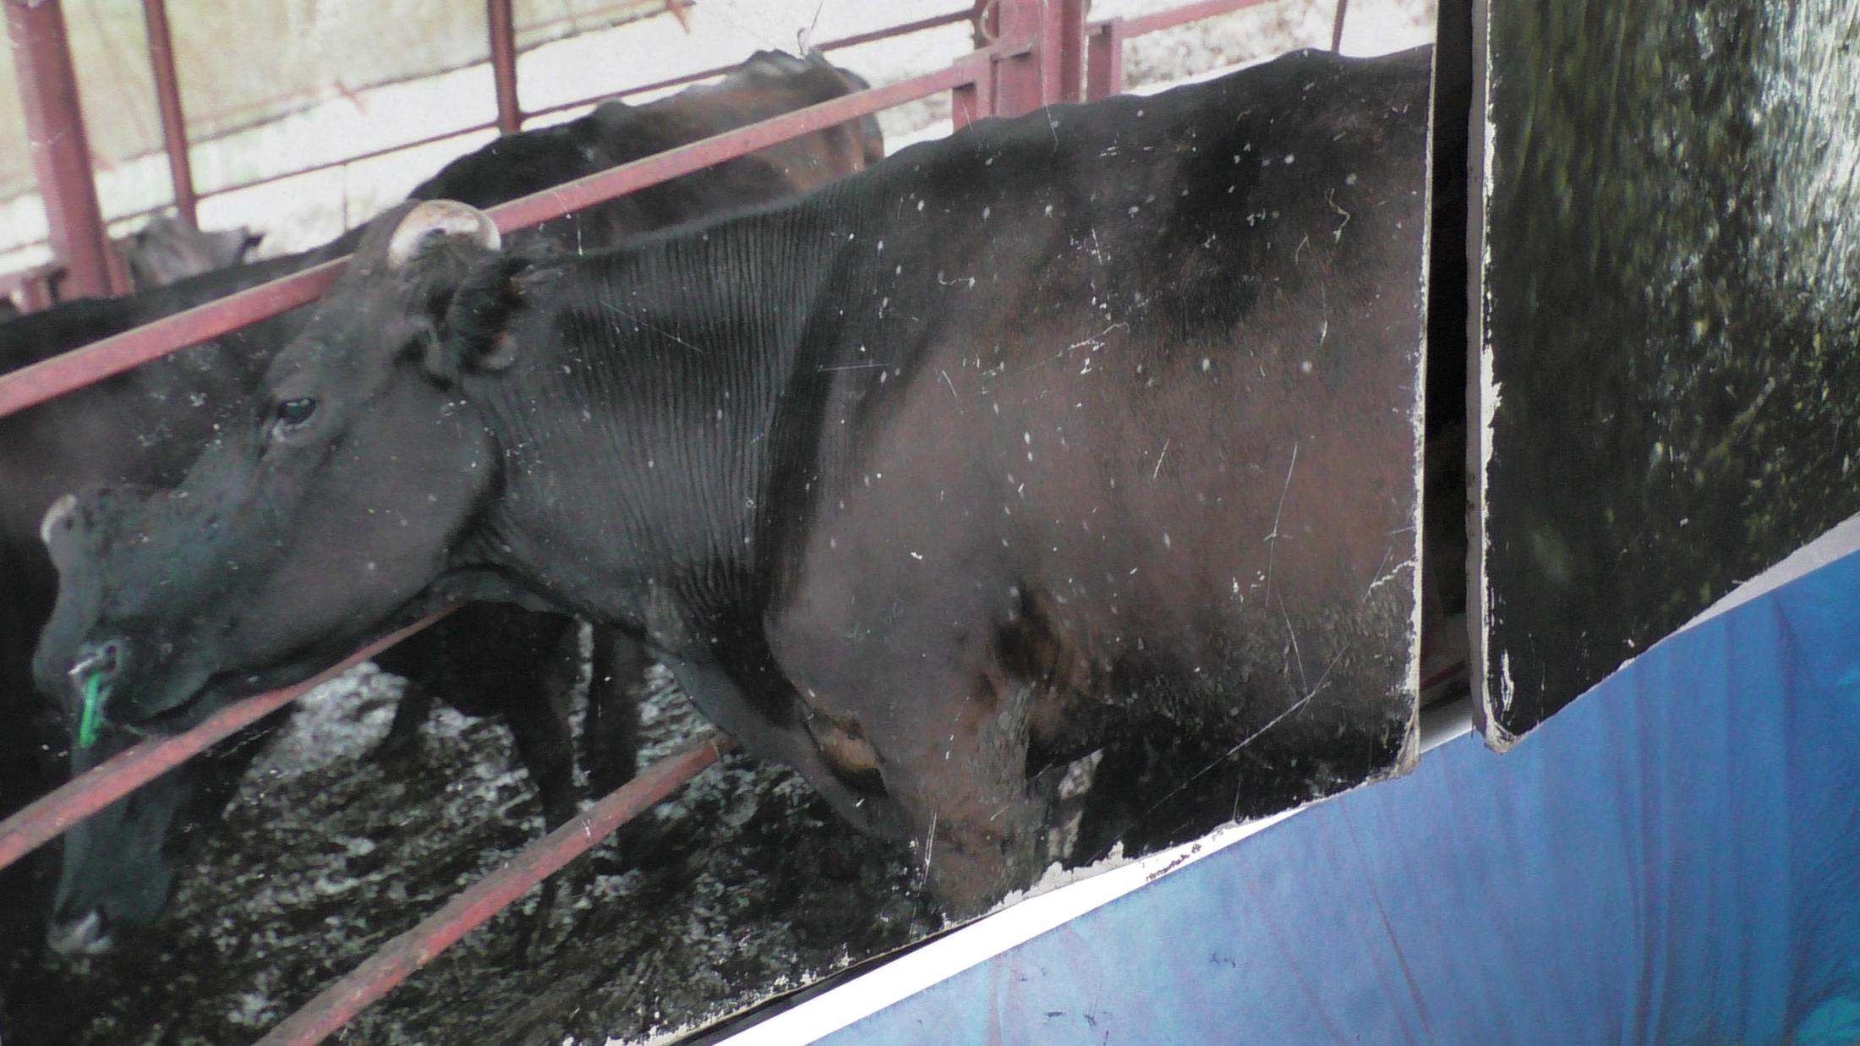
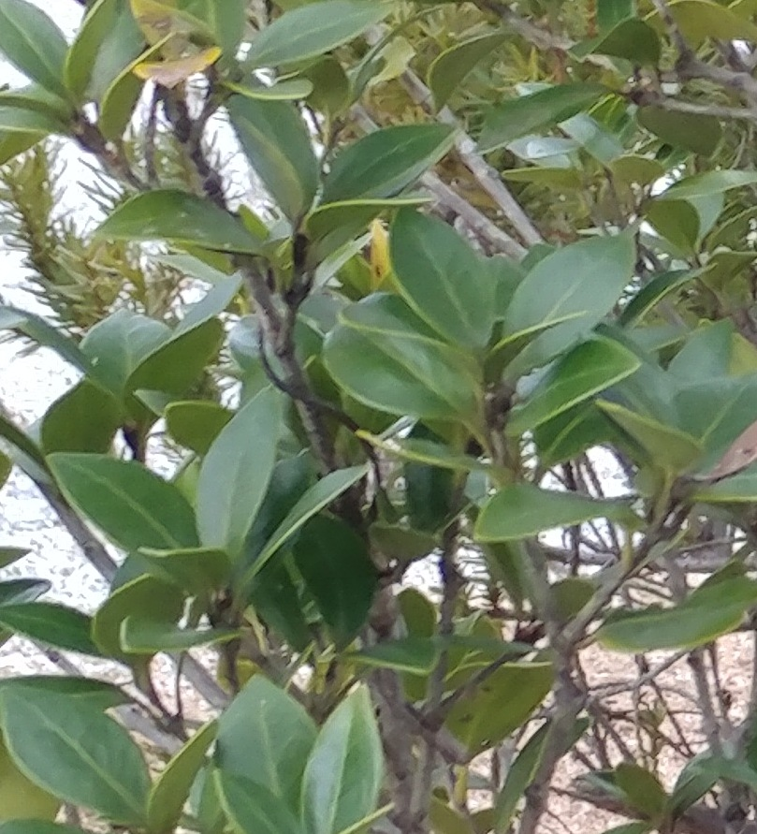
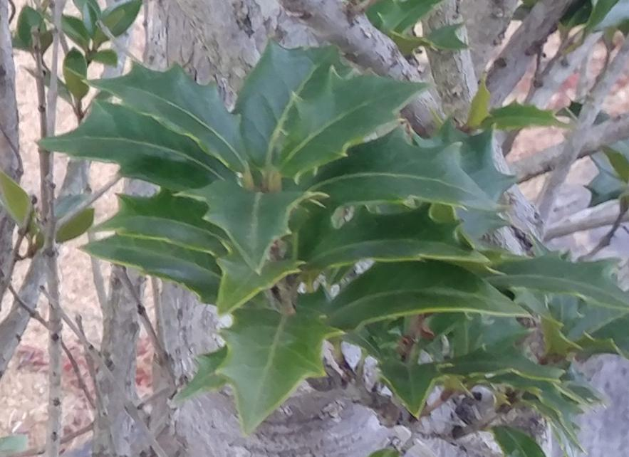
傷つけられた遺伝子
動物に見られる変化
  – 牛の白斑, 尾羽の揃わない鳥や羽色の違う鳥
植物に見られる変化
  - ギザギザが取れて丸くなってしまった葉っぱ
Notes:
Genetic Damage
Changed animals - cows with white spots, birds with unequal tail feathers and different coloring
Changed plants - pointed versus round leaves

Slide 46




表土を剥がれた土地
延々と続くフレコンバッグの山
有害物質が積まれた風景
津波現場に作られている有害物質を積んでカバーした堤防
Notes:
Fields with soil scraped off
Miles of garbage bags
Toxic landscaping, Tsunami Zone - toxic sea walls

Slide 47


今野寿美雄氏のストーリー
Stories from other evacuees -
* moved multiple times,
* may have to return to contaminated homes
* changed acceptable standards
* divorces
* subsidies being removed
Notes:
Sumio Konno story
Stories from other evacuees -
* moved multiple times,
* may have to return to contaminated homes
* changed acceptable standards
* divorces
* subsidies being removed

Slide 48
廃坑になったウラン鉱山の実態
西部15州に一万以上のウラン廃坑
50マイル圏内に一千万人強の人口
除染を義務付ける連邦法は無し
公的資金のめど打ち切りの見通しと共に企業は去る
半永久的に放置されるウラン鉱山

Slide 49
その他の教訓
除染作業は男性のみ。
なんちゃってプロジェクトばかり - プロパガンダ, 有害な堤防- 原発を建てた建設業者が今度は事故後のなんちゃって仕事で利益を貪っている
さらなる危険- 次の大惨事（地震, 津波、台風等）で、原発事故はもっと早く起こる
現政権は再稼働と新しい原発建設を推進
Notes:
Other lessons
Men only doing decontamination work, housing areas and restaurants for the workers 6000 of them
Make-work projects - propaganda building, toxic sea wall - many of the same huge companies that built the NPP now profit from its demise.
Additional danger - if another earthquake, tsunami or typhoon hits the NPP it could be an even faster disaster
Abe government approving restarting NPPs and wants more NPPs

Slide 50
核廃棄物
(looking for a good graphic for this)

Slide 51


日米原子力協定
もんじゅはプルトニウムを原料とするようデザインされており、一度も使われていない。 廃炉の予定。
日本ではプルトニウムを原料にできる技術は無い。
非常に高温で、水で冷やすと爆発するので、溶融ナトリウムで
冷やす必要がある。
青森県六ケ所村の再処理施設は2018年に稼働予定。
これが始まると、毎年８トンのプルトニウムを生産することになる。
稼働経費は約１４兆円。
関西電力の高浜原発の2機の原子炉はモックス燃料を使用している。
Notes:
US-Japan Nuclear Energy Cooperation Agreement
The Rokkasho Reprocessing Plant, scheduled to start in the fall of 2018. Pu Production Rate: 8 metric tons / year
Overall cost: $120 Billion
The Monju fast breeder reactor was designed to use plutonium as a fuel - never in full operation and will be decommissioned. Japan has almost no capacity to use plutonium for fuel. It is so hot it is cooled by molten sodium, which explodes on contact with water
Two reactors at Kansai Electric Power Co.’s Takahama plant in Fukui Prefecture that use mixed oxide fuel (MOX)
Signed in 1988, the agreement allows Japan to be the ony non-nuclear power that the U.S. allows to produce plutonium by reprocessing spent nuclear fuel.
Automatically renews July 2018 unless one of the countries objects - neither is currently planning to stop the renewal or renegotiate the wording.
Japan possesses roughly 48 tons of plutonium: 11 tons in Japan, 21 in UK, 16 in France.
Enough to make 6,000 nuclear bombs. Risks: Earthquakes, theft by terrorists

Slide 52
ゴールデンルール号は核のない未来へ再び航海します!
ベテランズフォーピース
ゴールデンルールプロジェクトwww.vfpgoldenruleproject.org
vfpgoldenruleproject@gmail.com
206-992-6364
ご寄付の送り先:
VFP Golden Rule Project
P.O. Box 87
Samoa, CA 95564

