Slide 1
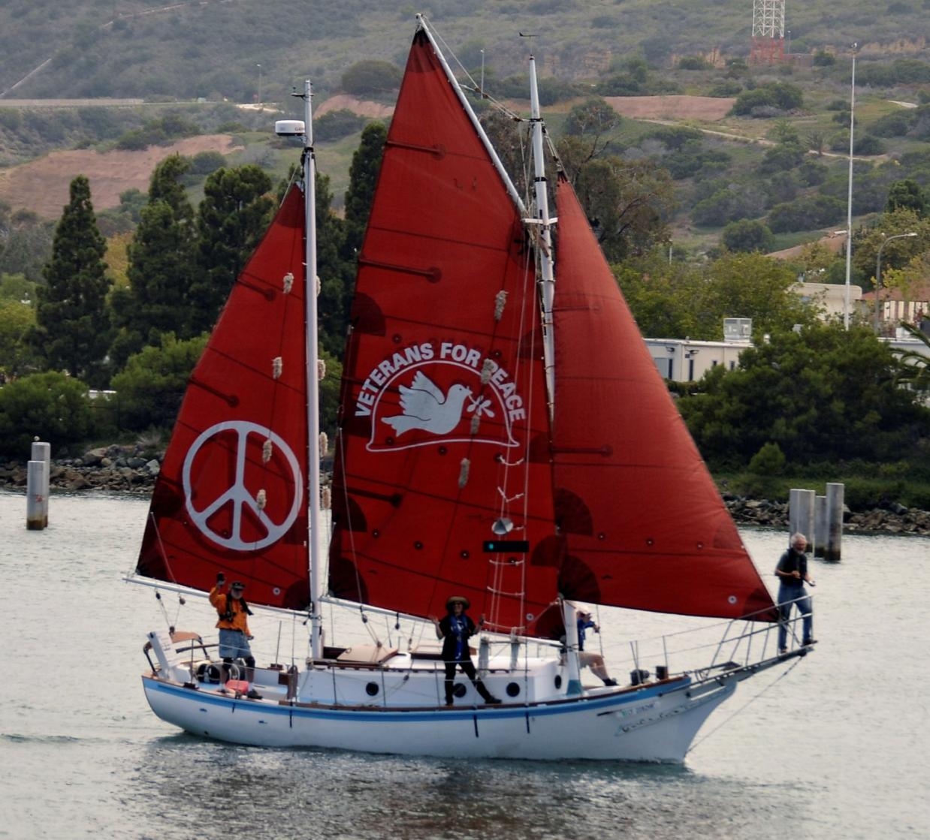

Slide 2
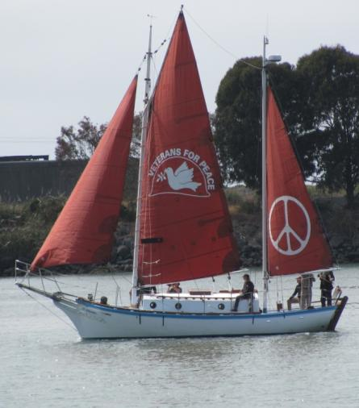
The Golden Rule:
Do Unto Others as you would have others do unto you
Don't do unto others as you would not have them do unto you!
Golden Rule Sails Again for a Nuclear Free Future!
Veterans For Peace
Golden Rule Project
www.vfpgoldenruleproject.org
vfpgoldenruleproject@gmail.com
(206) 992-6364, (314) 725-6005
VFP Golden Rule Project
P.O. Box 87
Samoa, CA 95564
February 2018
Hawaii
Gerry Condon
President, VFP Golden Rule Project
President, Veterans For Peace
Gerry@veteransforpeace.org
206-499-1220

Slide 3


The Golden Rule is a Project of
Veterans For Peace
Over 100 chapters, 10 international chapter
Over 2500 members
We aim to advance
Veterans For Peace opposition to nuclear weapons and war, and to do so in a dramatic fashion.

Slide 4
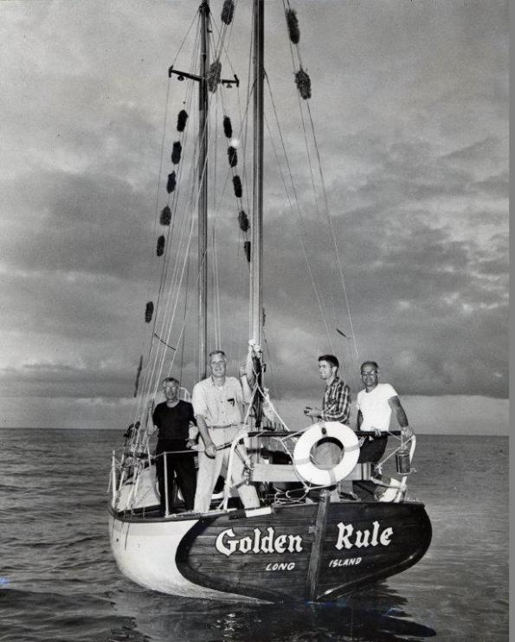
The Golden Rule:
1958 Mission and Motivation
William Huntington, Captain Albert Bigelow, Orion Sherwood and George Willoughby

Slide 5
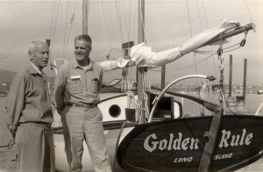
Bombing of Hiroshima and Nagasaki
Albert “Bert” Bigelow was a driving force behind the Golden Rule and the first skipper of the boat. As a Naval Officer during World War II (therefore a Veteran), he felt “under compulsion, under moral orders, as it were, to do this” (sail to stop nuclear bomb tests).
While captaining a destroyer escort, they approached Pearl Harbor from San Diego as the news arrived of the atomic bombing of Hiroshima.
“Intuitively it was then that I realized for the first time that morally war is impossible.”
He was proud that he resigned his commission a month before eligibility for a fullpension.

Slide 6
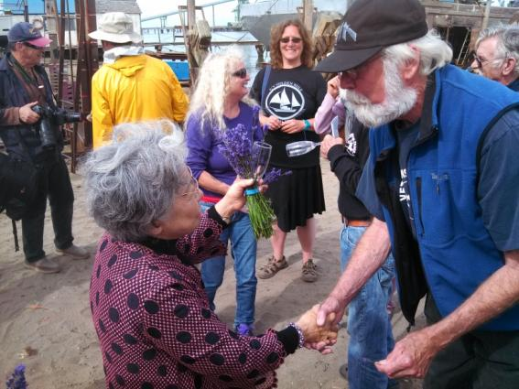
The Hiroshima Maidens
The Hiroshima Maidens were a huge influence on the original crew of Golden Rule in their decision to commit civil disobedience to stop bomb testing in the Pacific. Bert Bigelow’s family hosted two of the maidens, aged 7 and 13, for over a year.
Shigeko Sasamori, one of the Hiroshima Maidens who came to the U.S. for reconstructive surgery after surviving the Hiroshima bomb blast.
Mrs. Sasamori attended the launch of Golden Rule into
Humboldt Bay on June 20, 2015.

Slide 7
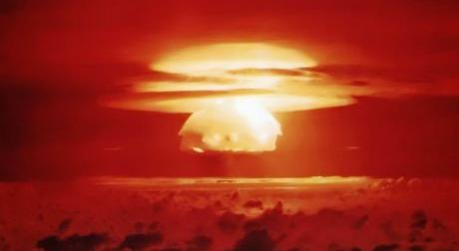
Nuclear Bomb Tests:
Bikini Atoll, Marshall Islands, 1954
In the Castle Bravo test the U.S. detonated a 15-megaton device equivalent to a thousand Hiroshima blasts.

Slide 8
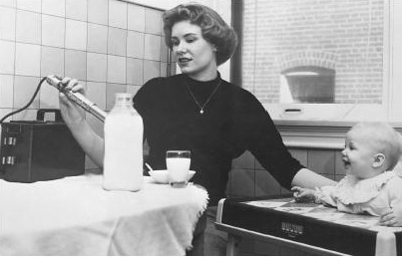
Strontium 90 in mother’s and cow’s milk
As a result of the atmospheric nuclear bomb tests by the U.S., U.K, and Russia, ⁹⁰Sr was found in milk, and the “Baby Tooth Survey” levels of ⁹⁰Sr were found to be 50 times higher between 1950 and 1963. Initial findings published in 1961 helped convince Kennedy in 1963 to sign the Partial Nuclear Test Ban Treaty.
Strontium 90 is not naturally occurring, but occurs only as a product of nuclear fission – from spent nuclear fuel and fallout from nuclear tests.
Sr90 acts like calcium in the body - it gets into the bones or breast milk, causing bone cancer and leukemia.

Slide 9
Laying the Foundation for Nonviolent Direct Action
Letters, calls, visits to Congress, the President
Letters, articles in newspapers, magazines
TV, radio interviews
Protests, demonstrations

Slide 10
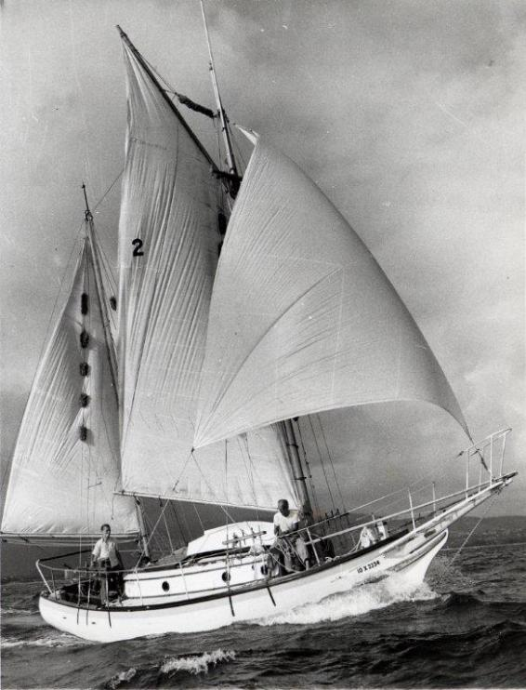
So, off they went…

Slide 11
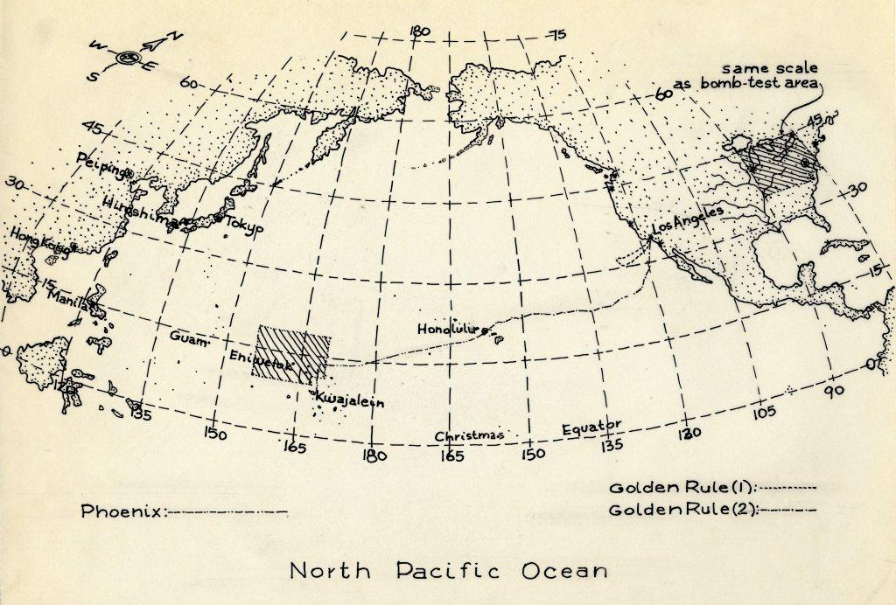
Sailing from California thru Hawaii to Marshall Islands

Slide 12
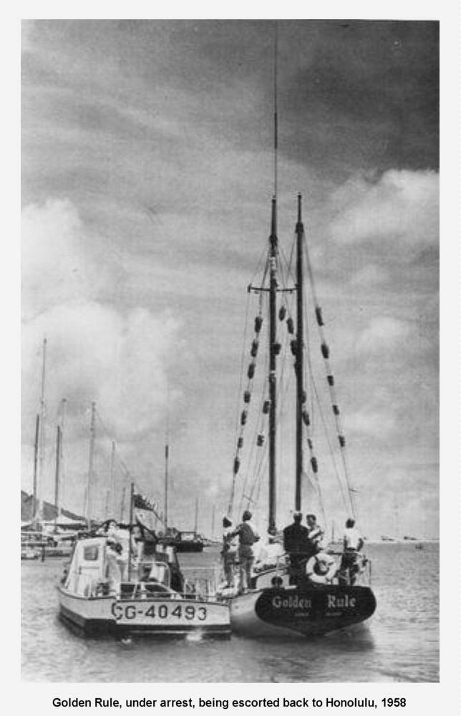

Slide 13
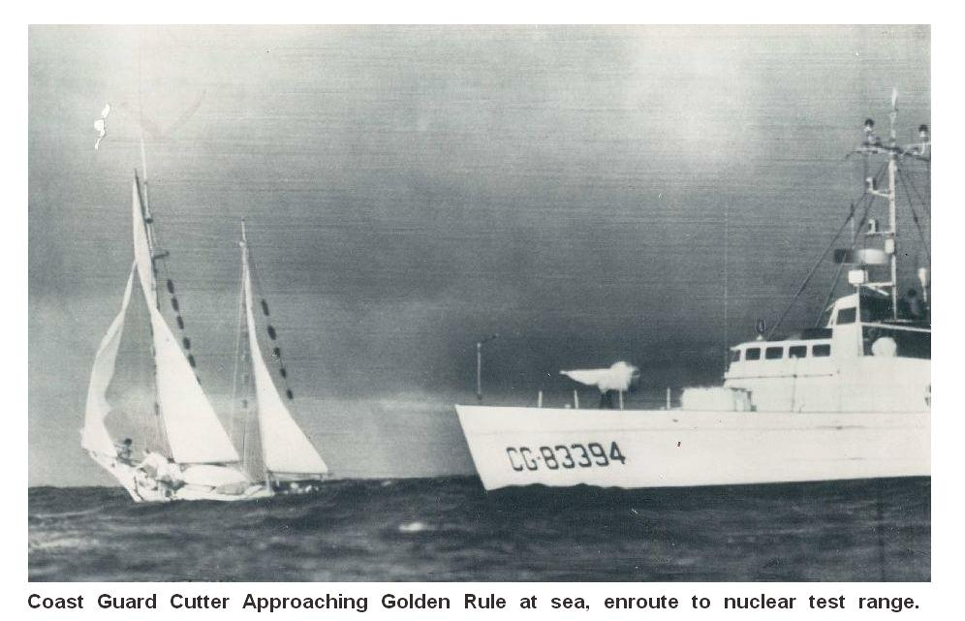

Slide 14
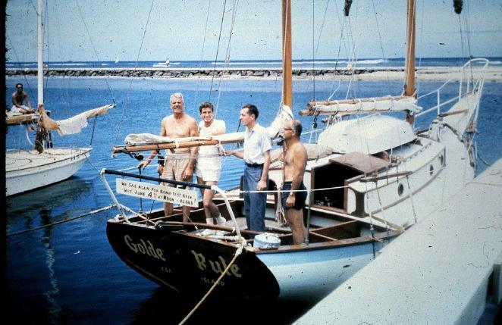
Arrested & Sentenced to 60 days in Jail
"WE SAIL AGAIN FOR BOMB-TEST AREA WED. JUNE 4TH AT NOON -- ALOHA!"
Crew, left to right: Capt. Albert S. Bigelow, Orion Sherwood, William Huntington, and George Willoughby
Photo courtesy of Jessica (Reynolds) Renshaw

Slide 15
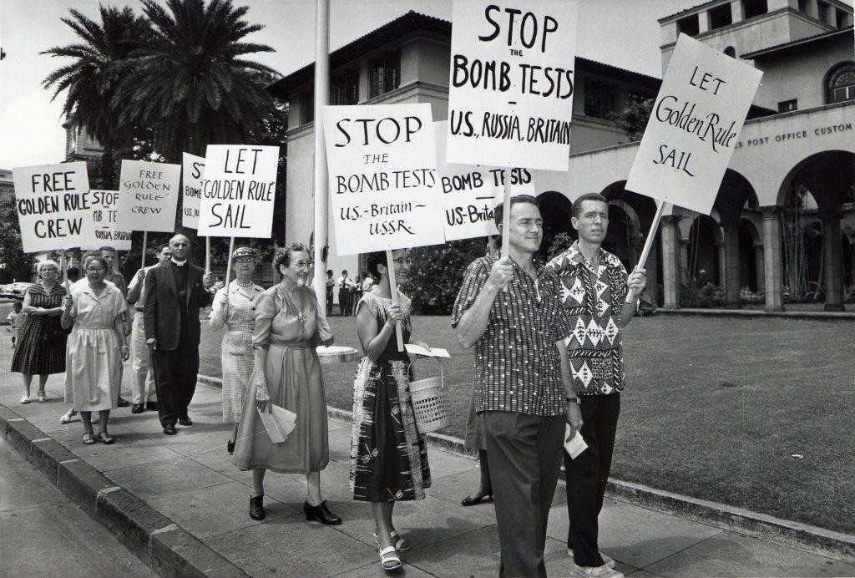
Anti-Nuclear Protests in Honolulu

Slide 16
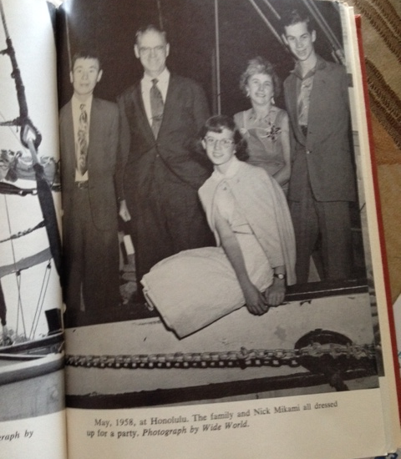
Phoenix was built in Hiroshima, Japan & sailed around the world by the Reynolds Family of 4 and their Japanese boat builder
Miichi (Nick) Mikami, Dr. Earle Reynolds, Jessica Reynolds, Barbara Reynolds, Ted Reynolds

Slide 17
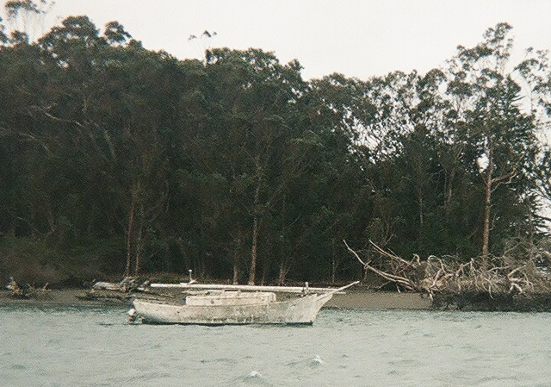
Golden Rule Found in 2010 in Humboldt Bay, Eureka, California

Slide 18
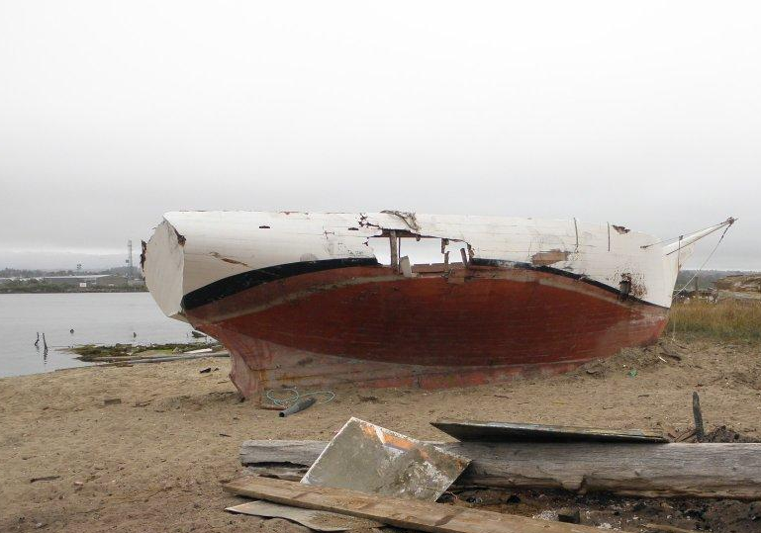

Slide 19
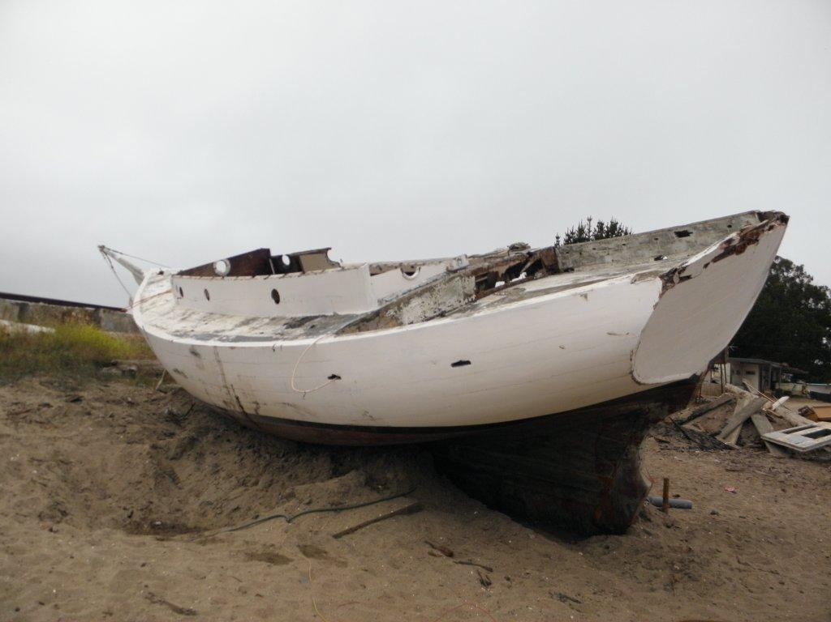

Slide 20
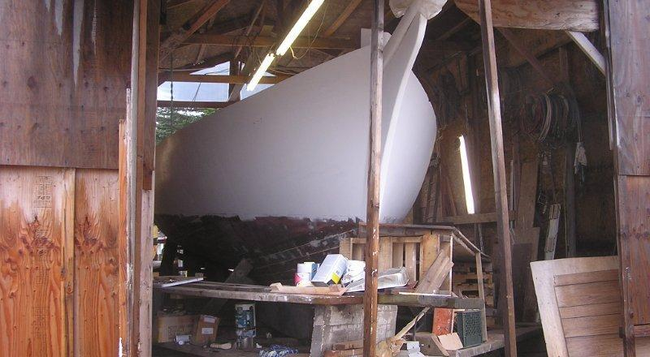
Restoration of The Golden Rule

Slide 21
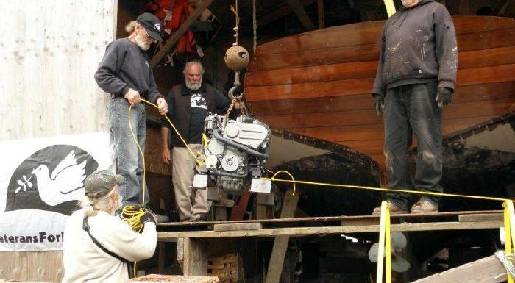

Slide 22
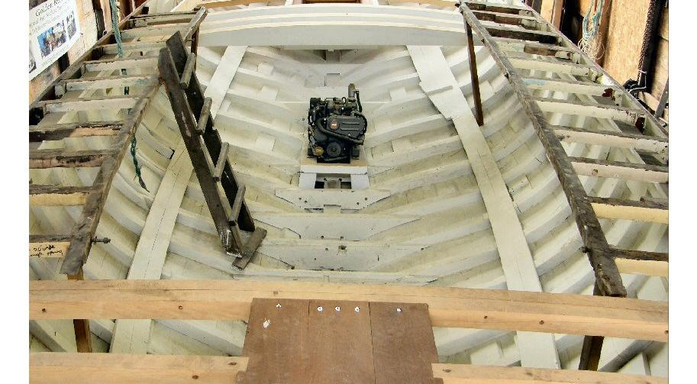
Restoring the inside of The Golden Rule

Slide 23
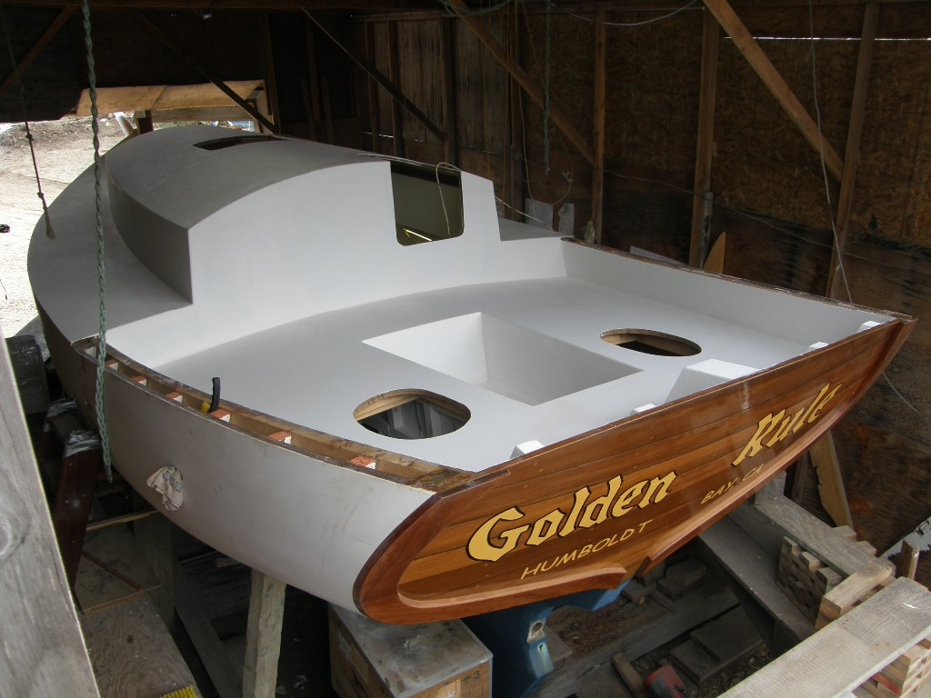
Restoration by Veterans for Peace

Slide 24
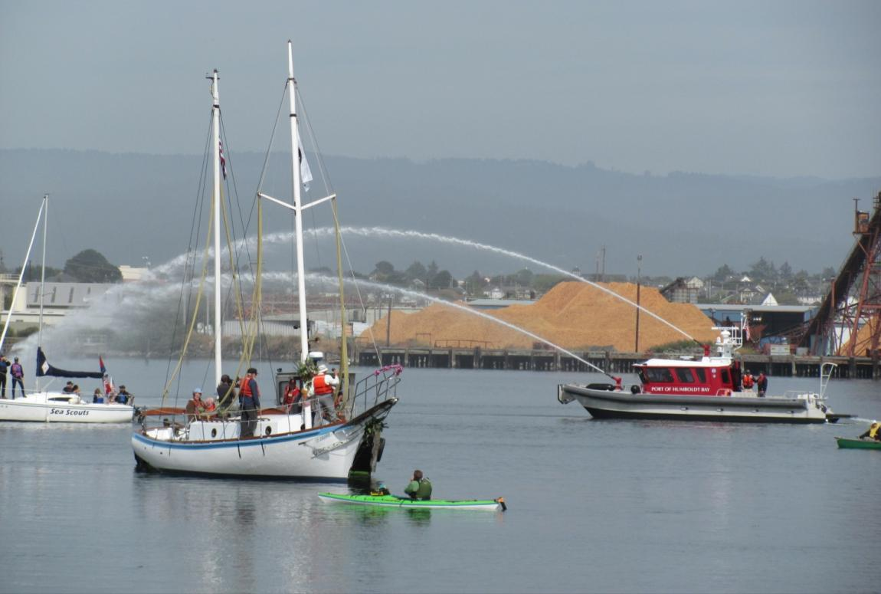
Launch!
June 20, 2015

Slide 25
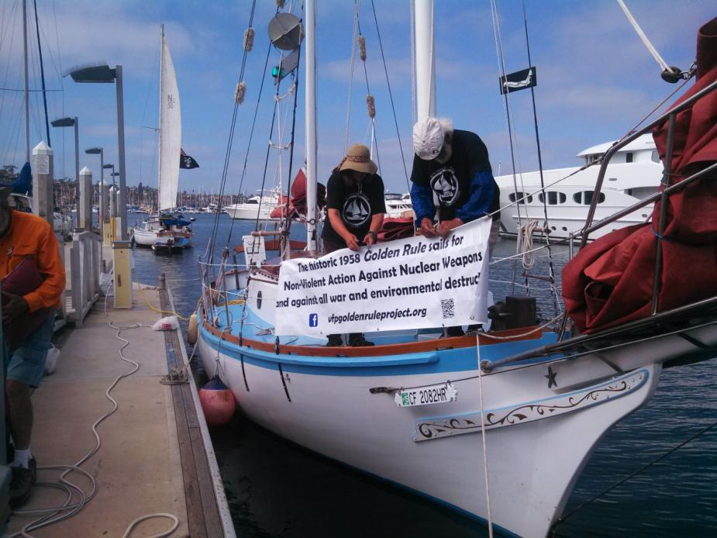
Arrival in San Diego
At least 3 TV stations, 1 radio station, and 1 newspaper covered our arrival! We were met by VFP members and supporters and Golden Rule was the “sparkle” in the VFP National Convention!

Slide 26
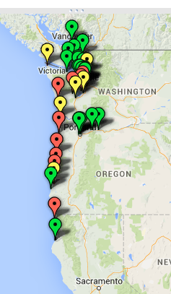
2016 Voyage
Nonviolent Direct Action
  Indian Island Munitions Transfer Station
  Fleet Week: Portland, Seattle
  Boats By Bangor
Inspiring the Choir: 25 Educational Events
  Portland (2) Hood River
  Stevenson Vancouver, WA
  Port Townsend Seattle (5)
  Kirkland Kenmore
  Bainbridge Island Poulsbo
  Olympia Seabeck
  Ground Zero Center Coupeville
  Bellingham Friday Harbor
  Victoria, BC (2) Astoria
  Newport
Beyond the Choir:
  4 Wooden Boat Shows
    Seattle, Vancouver BC, Victoria BC, Port Townsend
  Indigenous Canoe Journey
  Boat Tours and Sailing
  Flyers at public events – Rose Festival , Seafair, From Hiroshima to Hope

Slide 27
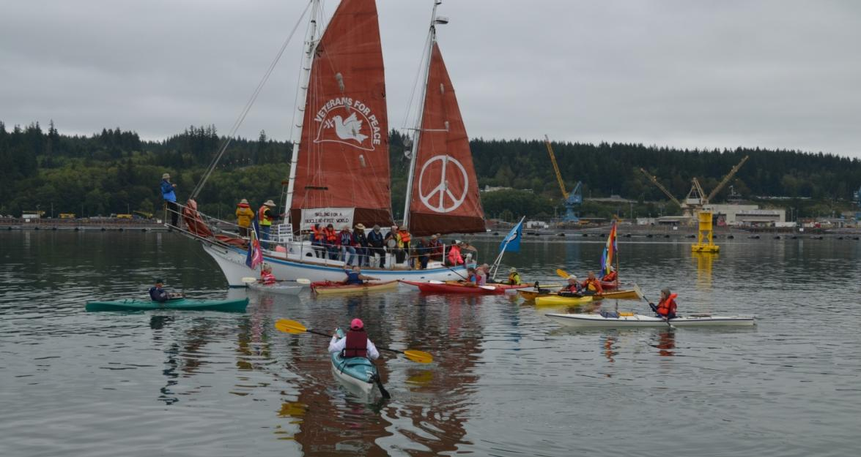
Boats by Bangor
Eight Trident Nuclear Submarines home-ported just 25 miles from Seattle
Each carries enough bombs to bring nuclear winter and kill all life on earth
The Bangor base on Hood Canal has the largest stockpile of nuclear weapons in the US

Slide 28
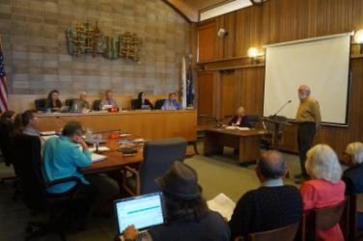
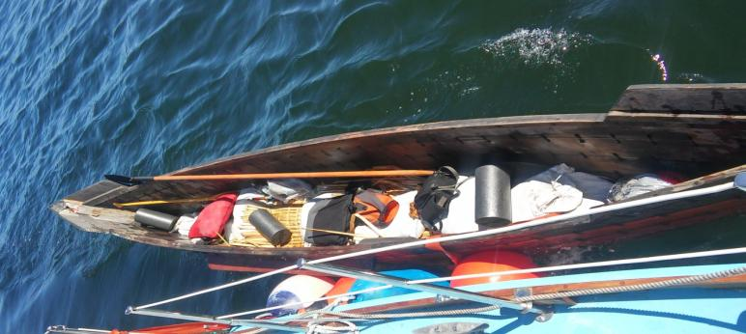
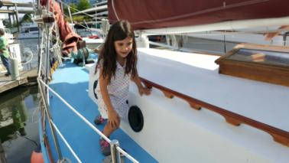
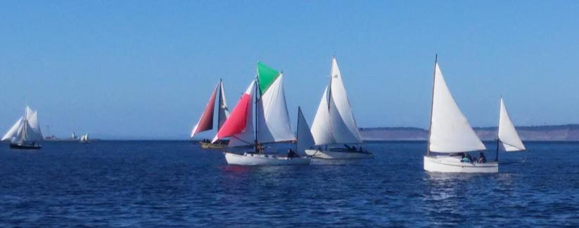
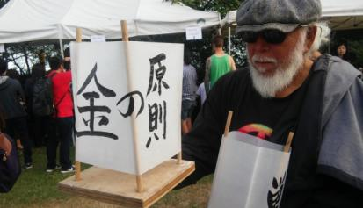
Reaching Beyond The Choir
Local Governments
Indigenous Canoe Journey Support
Boat Tours, Go Sailing
Wooden Boat Shows and Races
Participate in local events

Slide 29
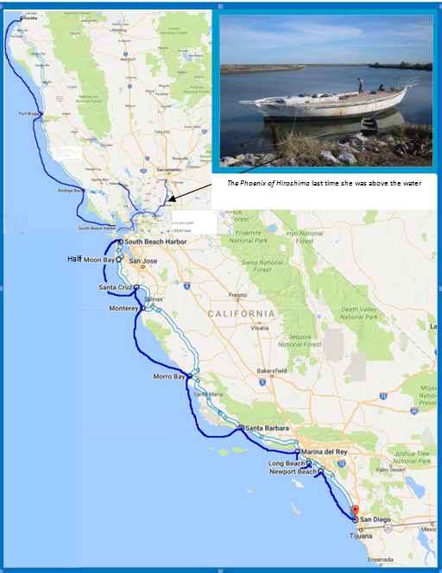
2017 Voyage: California Coast

Slide 30
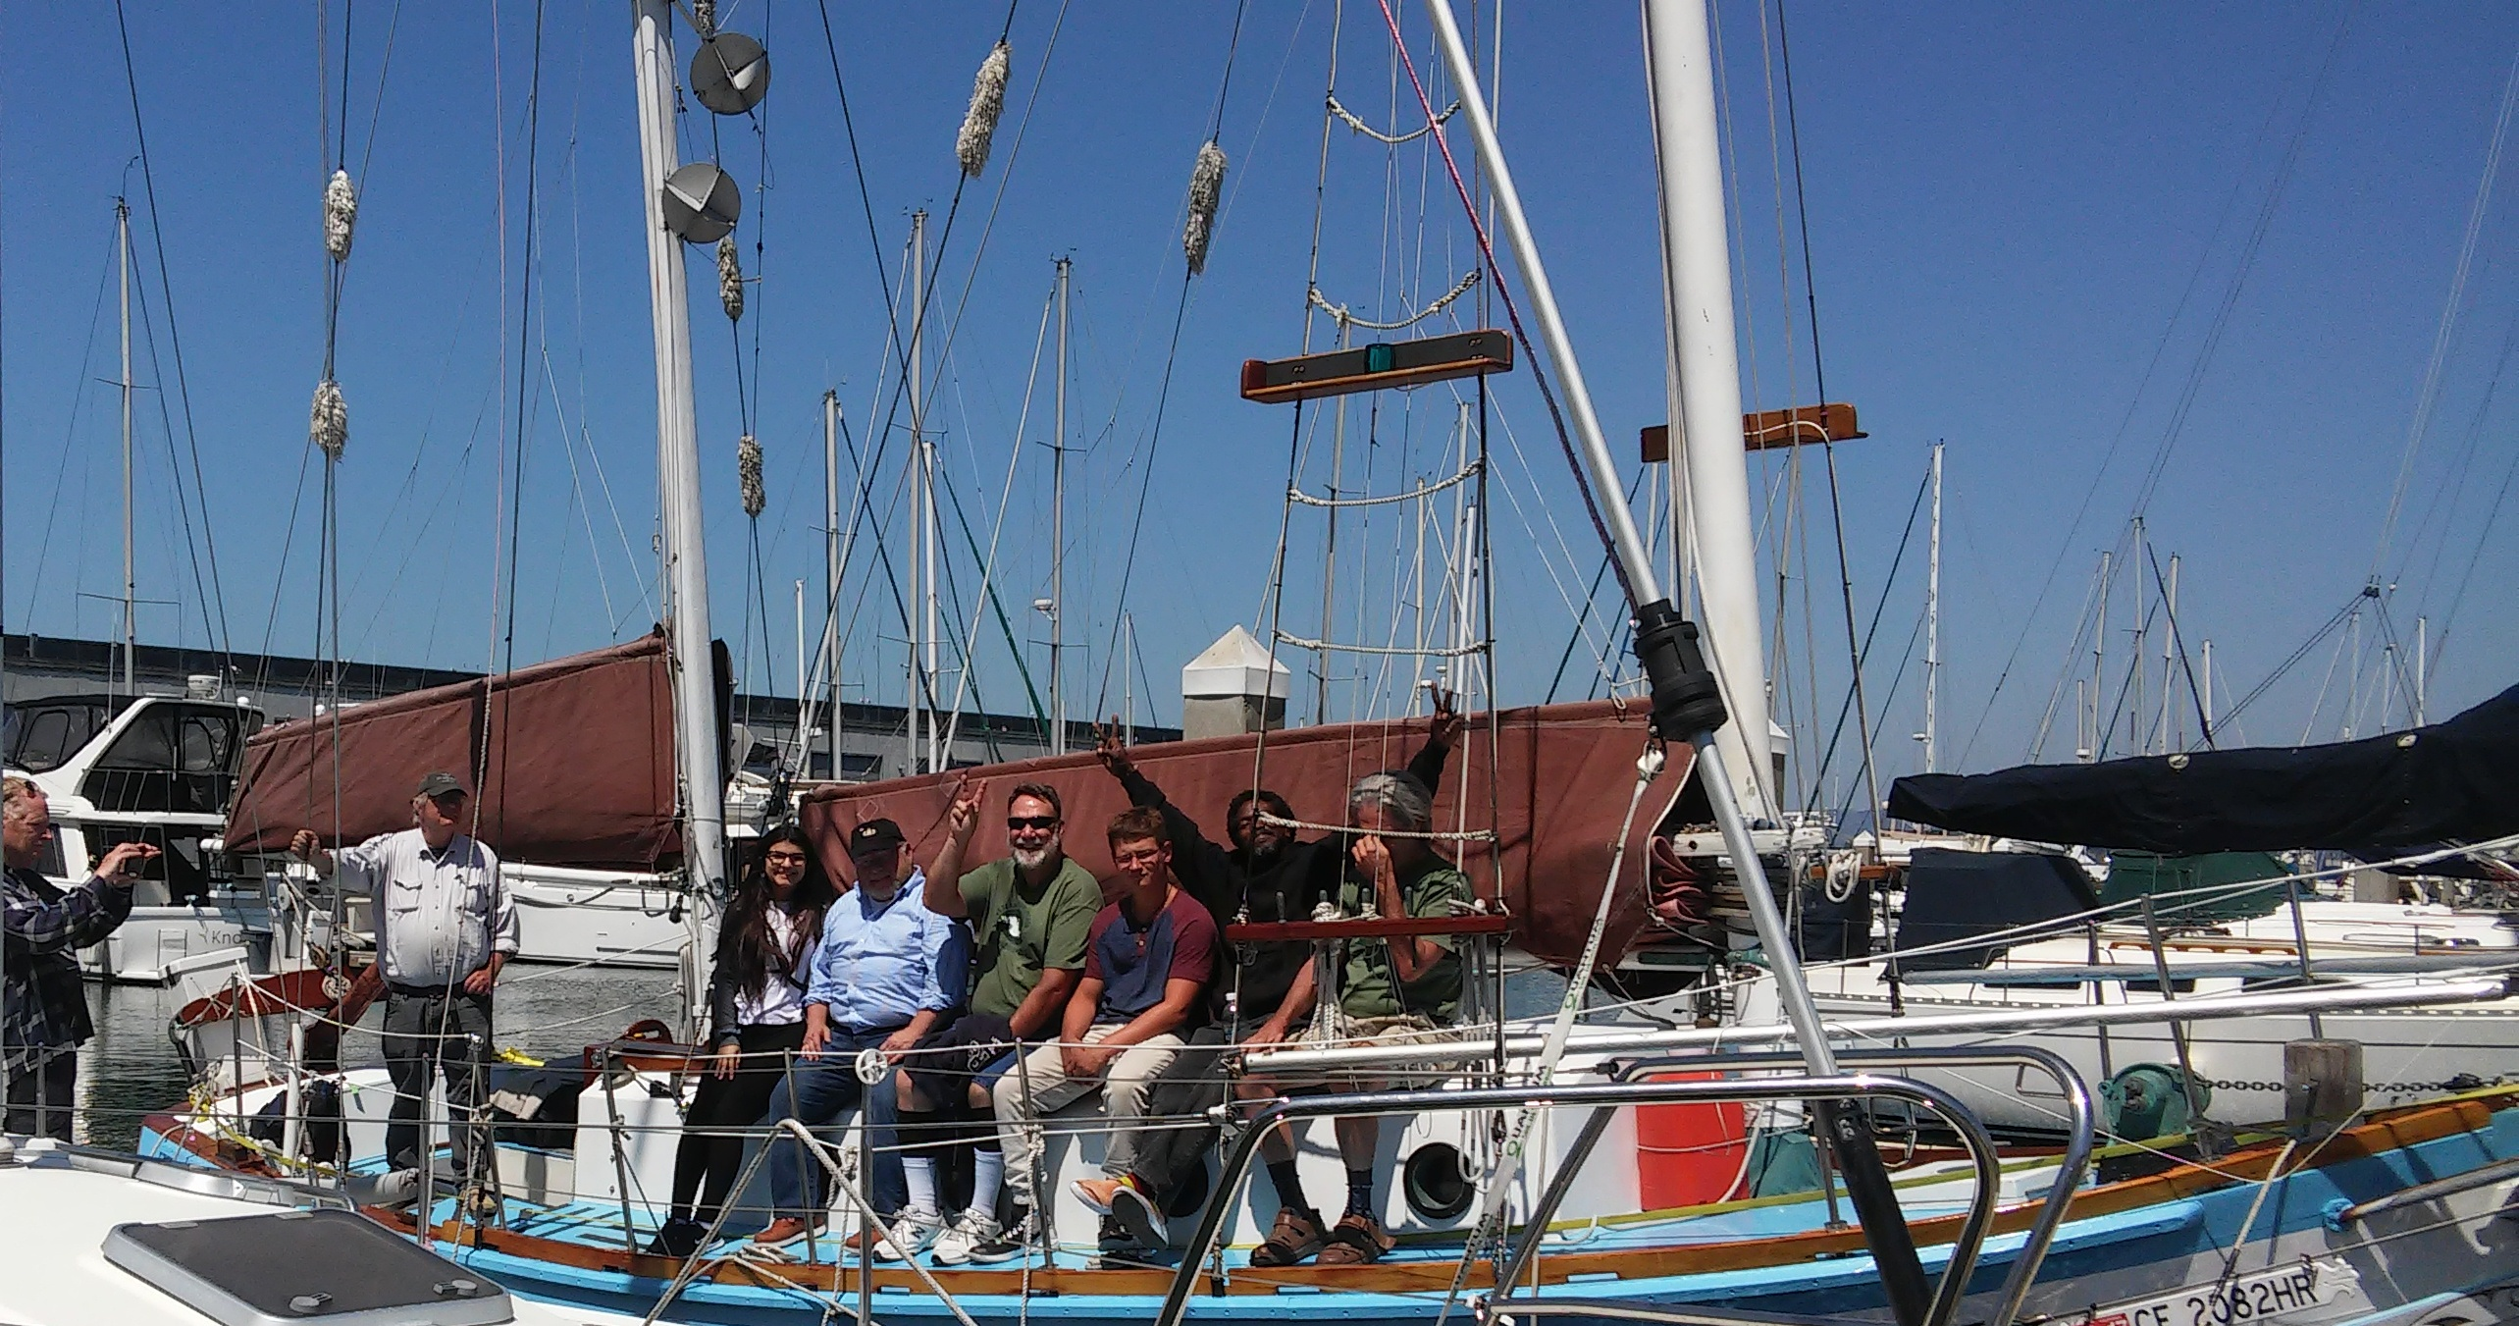
Peace Action Camp
A chance for veterans, youth, women and others to join together to learn to sail, learn the principles of non-violent direct action, and learn about nuclear issues today.

Slide 31
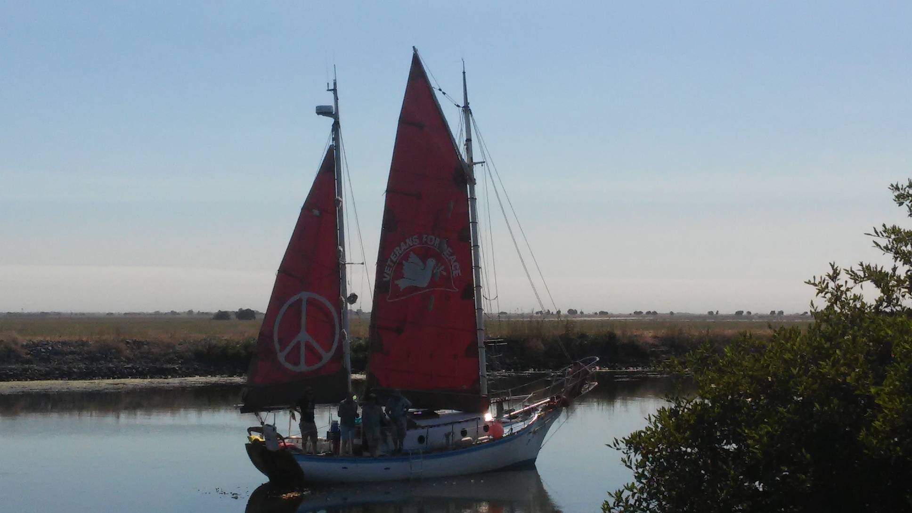
The Phoenix and The Golden Rule Reunite

Slide 32
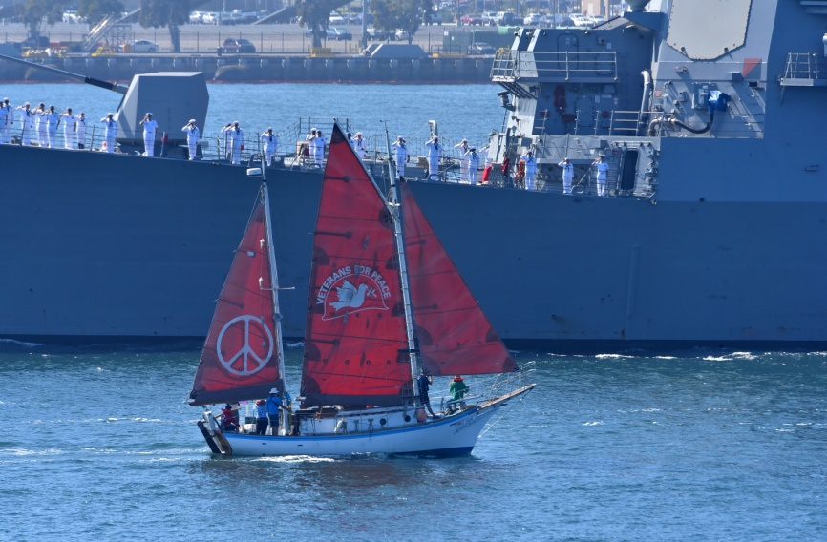
Fleet Week, San Diego
Navy salutes the Golden Rule
Photo: Chris Stone, Times of San Diego

Slide 33
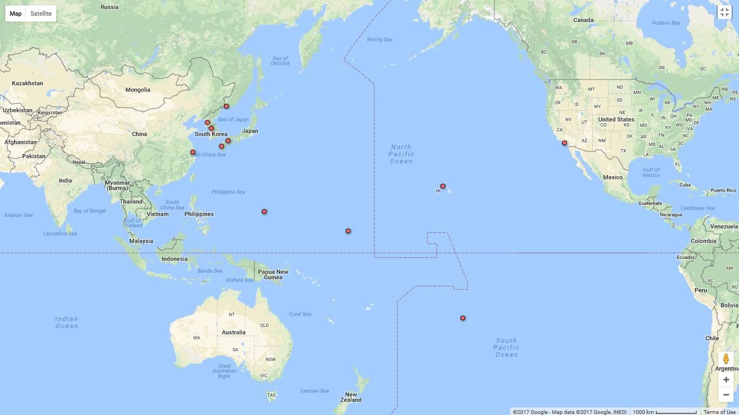
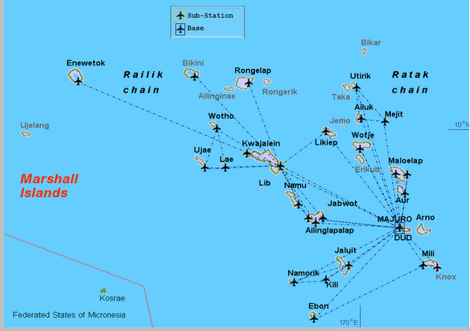
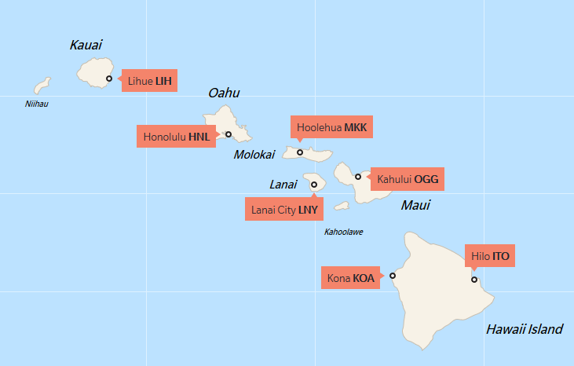
2018-2021 Overall Sailing Plan
Vladivostok, Russia
Pyongyang, N Korea
Seoul
Hiroshima
Shanghai, China
Nagasaki
Okinawa
Hawaii
Guam
Marshall Islands

Slide 34
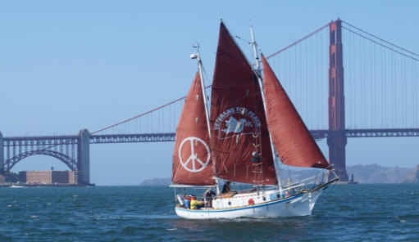
How to Get Involved with the VFP Golden Rule Project
Crew
Organize events
Be a liaison with anti-nuclear or peace groups
Write petitions, articles, letters to the editor
Become a Golden Rule Ambassador (Public Speaker)
Photograph or Video - publicize and document
Design banners and posters
Maintain the boat
Provide shore support and advice
Help connect us with your community
Post to our Facebook Page
Write and share your Golden Rule art, music, poetry, play, or street theater

Slide 35
Nuclear Issues Today
Increased Threat of Nuclear War –
  Conflicts between Nuclear States
  New, more deadly, useable nuclear weapons
Nuclear Power – Meltdowns, Waste, Money
Uranium Mines, Mills, Transport, Processing – killing and contaminating - then and now

Slide 36
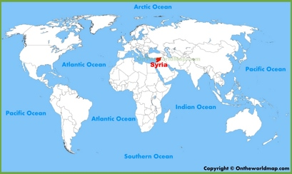
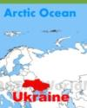
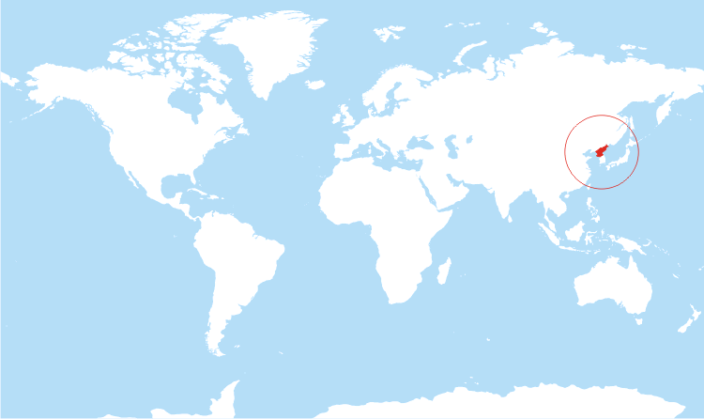

Conflicts between Nuclear-Armed States
Kashmir
Korea
Ukraine: US, Russia
Syria: US, Russia
Kashmir: India, Pakistan
S. China Sea, other Asian areas: US, China
Korea: US, Russia, China, N. Korea, S. Korea
Notes:
http://drrajivdesaimd.com/2012/08/01/the-war/

Slide 37
Nuclear Posture Review

Slide 38
  New nuclear weapons under the guise of “Life Extension” or “Modernization”
$1,000,000,000 (One Trillion Dollars) planned for 2 new nuclear weapons and 3 new nuclear weapon delivery systems in the U.S. alone.
Development of smaller, therefore more useable nuclear weapons
Expansion of when the U.S. might use nuclear weapons - on non-nuclear states, for cyber attacks, to protect “U.S. Interests”, first strike for “prevention”
Russia and China are also “modernizing” their nuclear weapons.

Slide 39
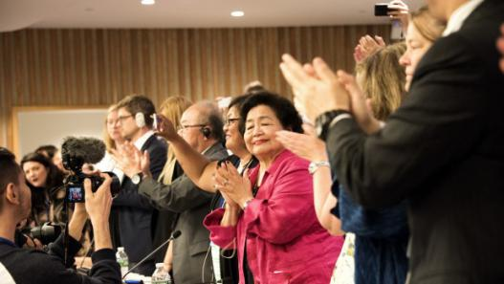
UN Votes to Ban the Bomb!
On July 7, 2017 the United Nations overwhelmingly passed the historic UN Treaty on the Prohibition of Nuclear Weapons. Once ratified by legislative bodies in 50 countries (it was approved by 122 countries) the UN Treaty will make it illegal to possess, use, deploy, transfer or threaten to use nuclear weapons.
Notes:
James Martin Center for Nonproliferation Studies at the Middlebury Institute of International Studies at Monterey

Slide 40
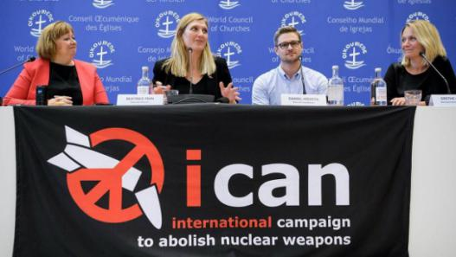
Nobel Peace Prize Awarded to Anti-nuclear Activists
In early October, the 2017 Nobel Peace Prize was awarded to the International Campaign to Abolitish Nuclear Weapons (ICAN), in large part because of its work to support the UN treaty to ban nuclear weapons.
ICAN accepted the Nobel Peace Prize on behalf of all who have been campaigning for so many years for nuclear disarmament. The VFP Golden Rule Project is relatively new on the scene, but many longtime disarmament activists tell us that we have put wind in their sails. So we will gladly (but not so humbly) accept our little part of the Nobel Peace Prize. After all, the intent of the Nobel Committee is to encourage urgent efforts to rid the planet of these weapons of self-destruction.

Slide 41
What you can do to reduce the possibility of nuclear war
Encourage US ratification of the UN Nuclear Weapons Ban
Support the Markey-Lieu bill – The US shall not strike first with nuclear weapons without a Congressional Declaration of War

Slide 42
Nuclear Power
Nuclear power plants routinely release radioactivity, are at risk of melt-down, and produce fuel rods containing plutonium for bombs.
Nuclear Power is absolutely necessary to build nuclear bombs - that is how Plutonium is produced. That is the real reason the U.S. government supports nuclear power.

Slide 43
Abandoned uranium mines
15,000 Abandoned Uranium Mines are poisoning our waters, soil, and air, with no standards or national plan for cleanup.

Slide 44
Nuclear Waste
There is no safe way to store nuclear waste and disposal is a huge problem.
  Yucca Mountain is not a safe disposal site
  Hanford Nuclear Reservation won’t be clean / safe for decades, if ever.

Slide 45
Golden Rule Sails Again for a Nuclear Free Future!
Veterans For Peace Golden Rule Project
www.vfpgoldenruleproject.org
vfpgoldenruleproject@gmail.com
206-992-6364
Donations:
VFP Golden Rule Project
P.O. Box 87
Samoa, CA 95564

